Slide 1
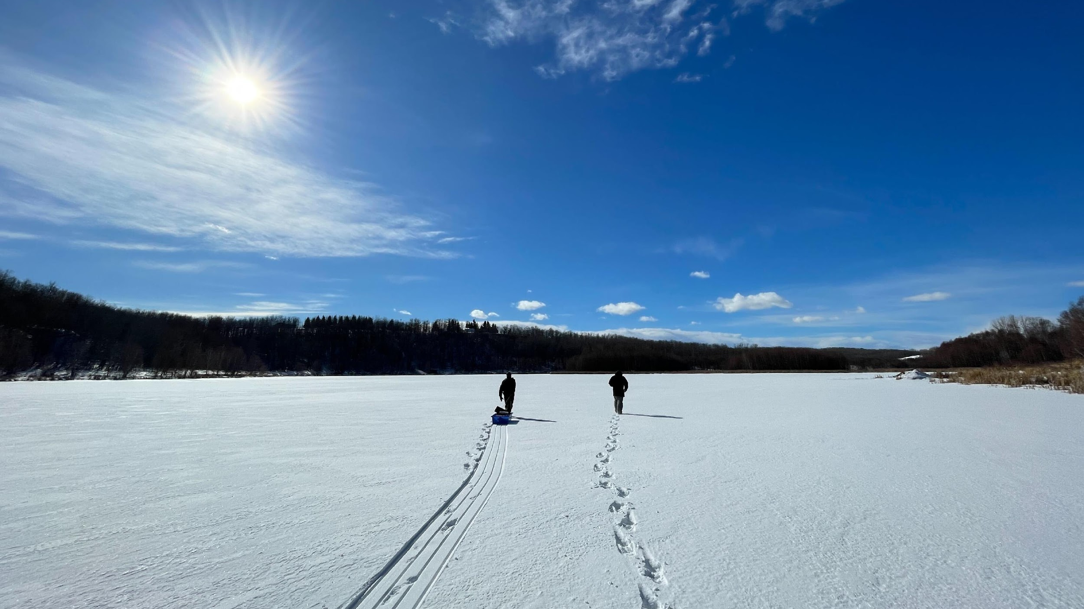
2023-2024 ALMS Annual Report

Slide 2
Land Acknowledgement

Slide 3
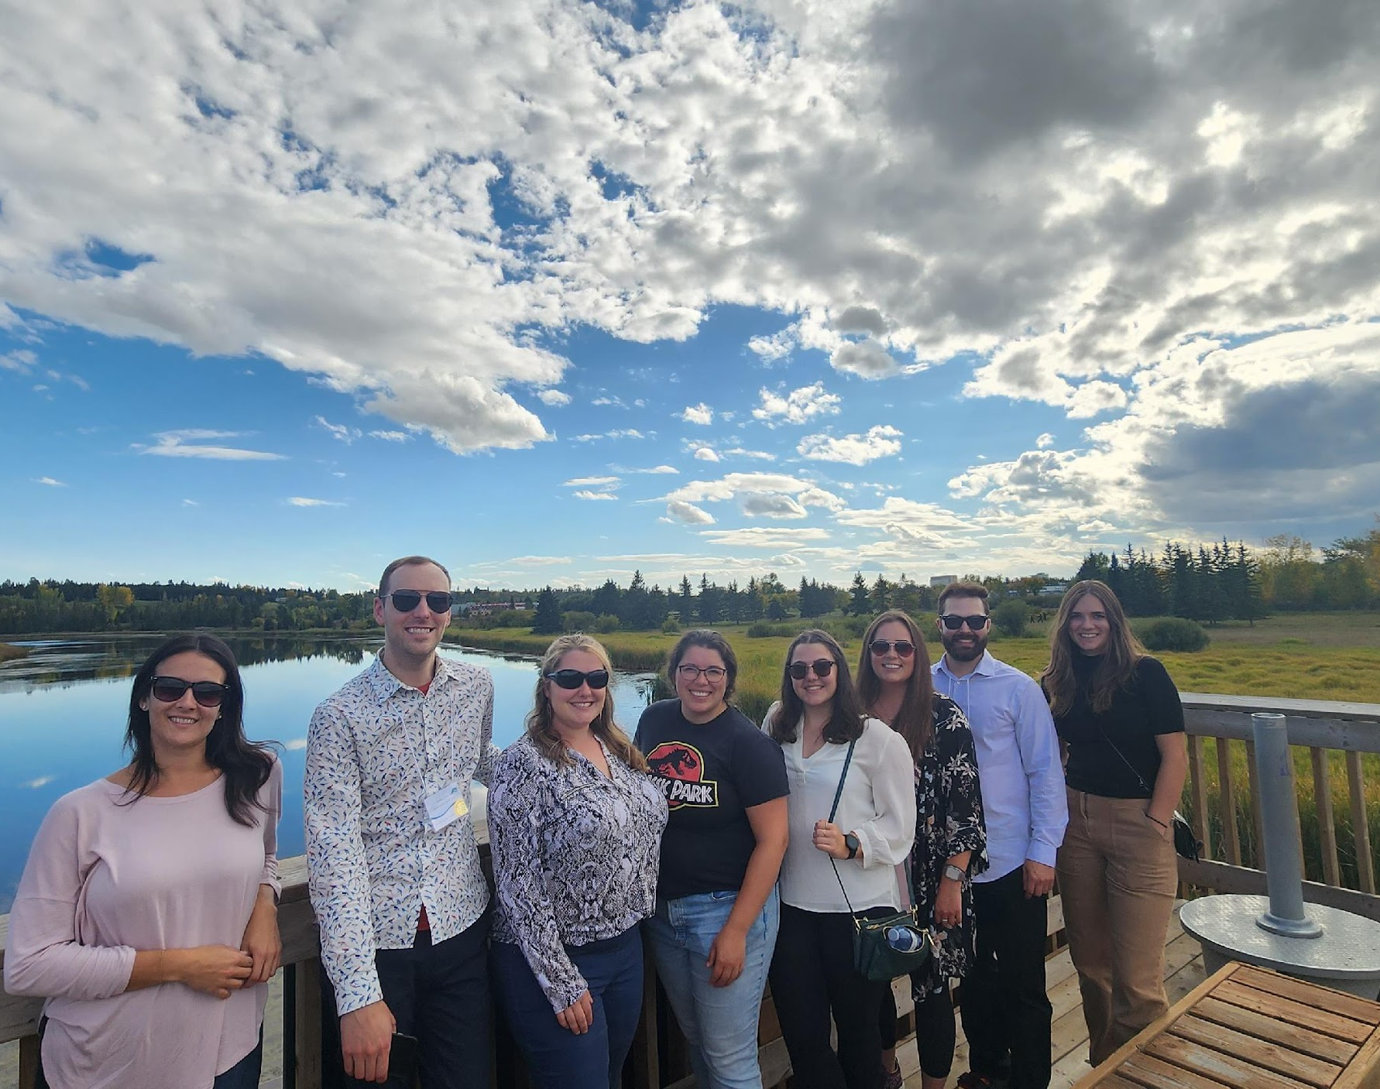
Current Staff
Bradley Peter: Executive Director
Kurstyn Perrin: ICBM Program Coordinator
Brittany Onysyk: Program Manager
Kirsten Letendre: Program Technician
ALMS staff at the 2023 Annual Conference in Sylvan Lake.

Slide 4
Thank you for your financial support.

Slide 5
Thank you for your financial support.

Slide 6
Thank you for your financial support.

Slide 7
Strategic Objective: Building Community
Dependable and Adaptable Communication
Strategic Engagement for Advancing our Mission

Slide 8
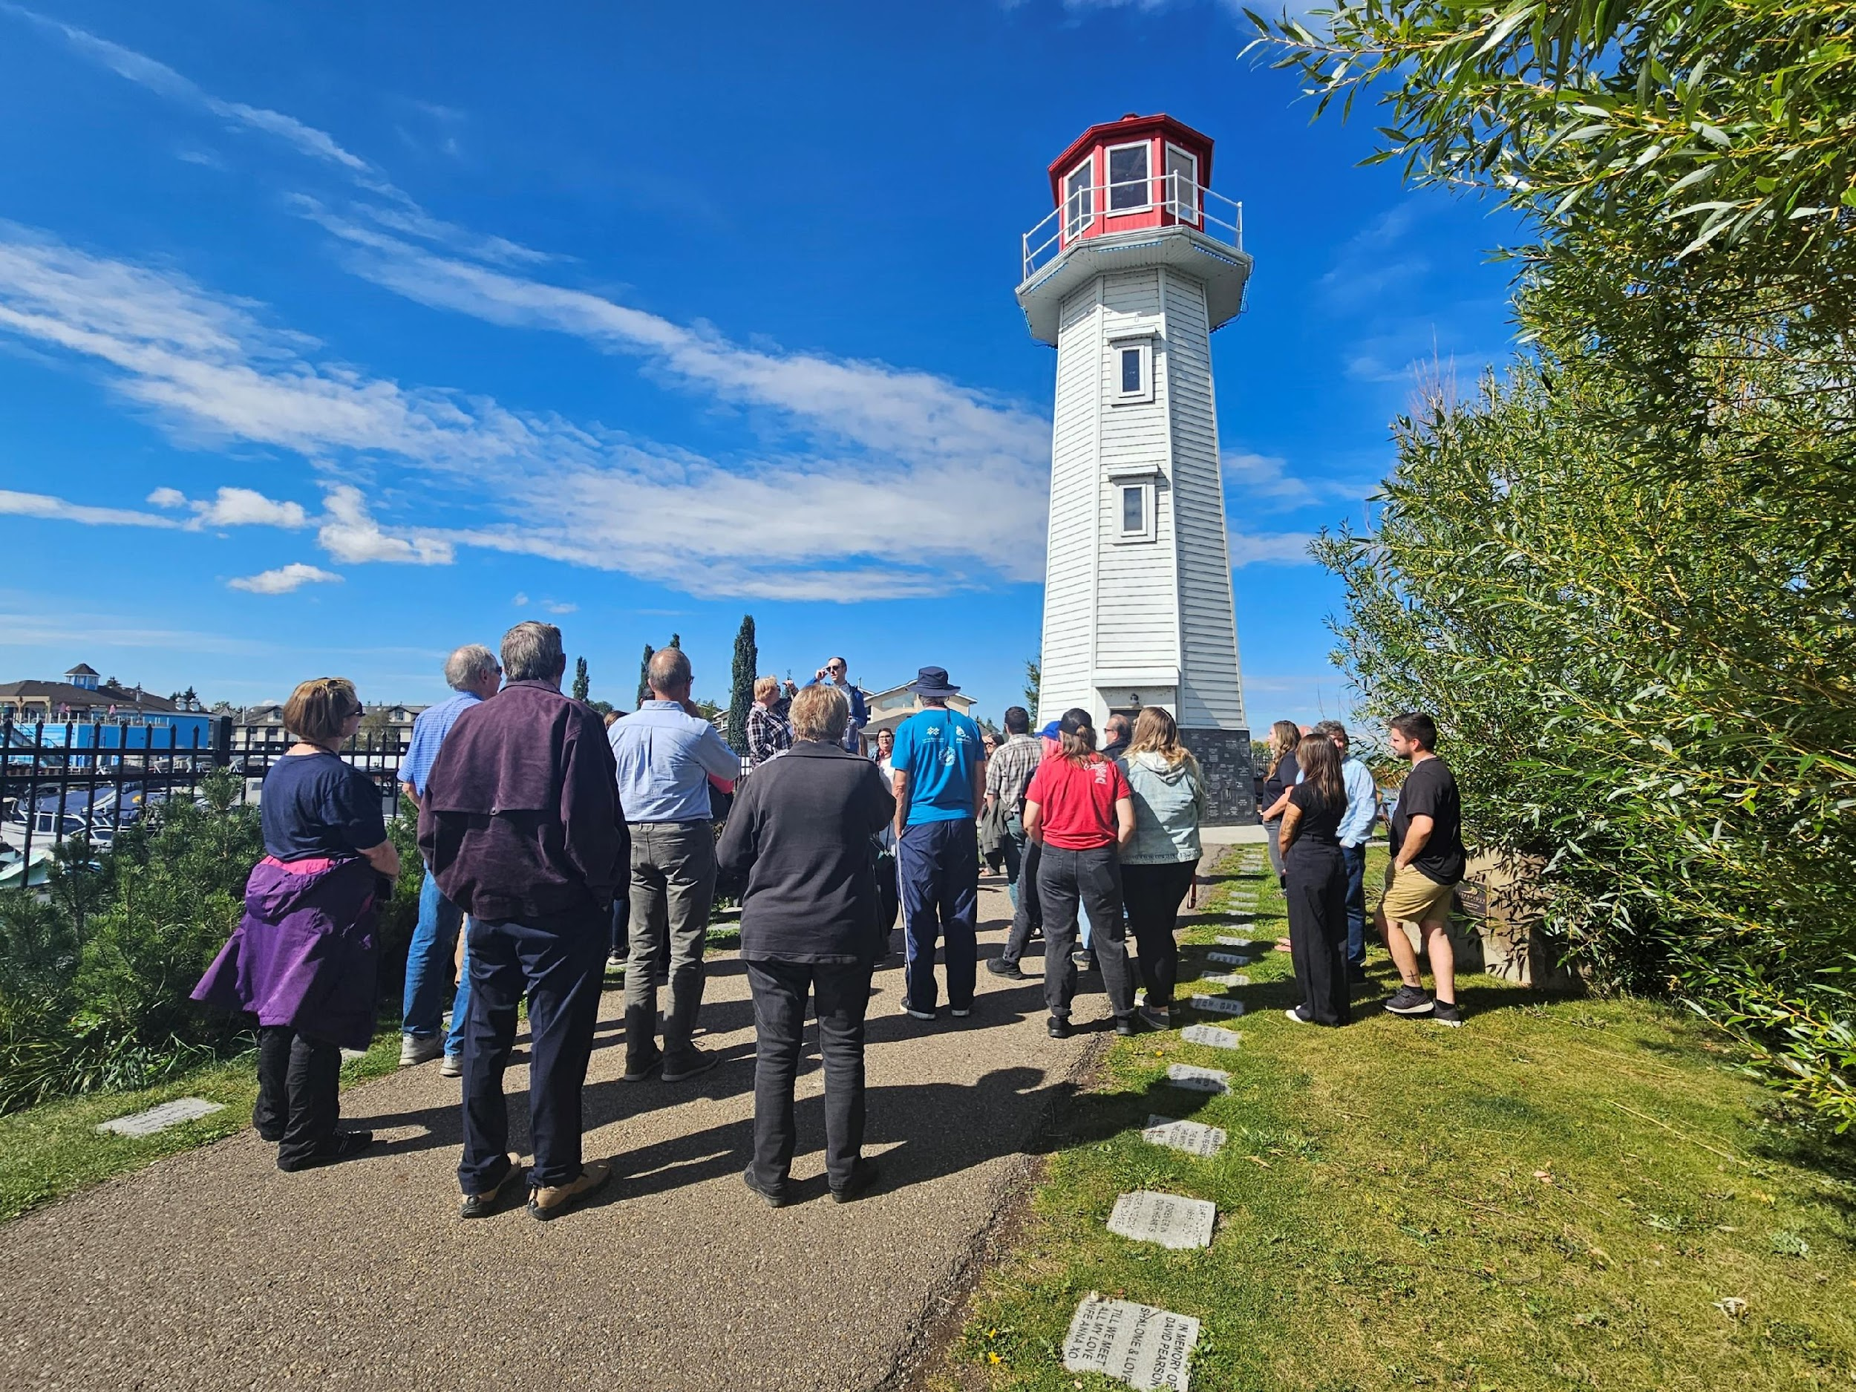
2023 Annual Conference
September 12-13 in Sylvan Lake.
17 speakers
75 attendees
Key Topics:
Piping plover conservation
Satellite visualization of algae blooms
Bulrush restoration
Nitrate contamination
Disturbance standards for seasonal docks
Presentations available online at alms.ca/2023-annual-conference.
ALMS workshop attendees visiting Lighthouse Park on Sylvan Lake.

Slide 9
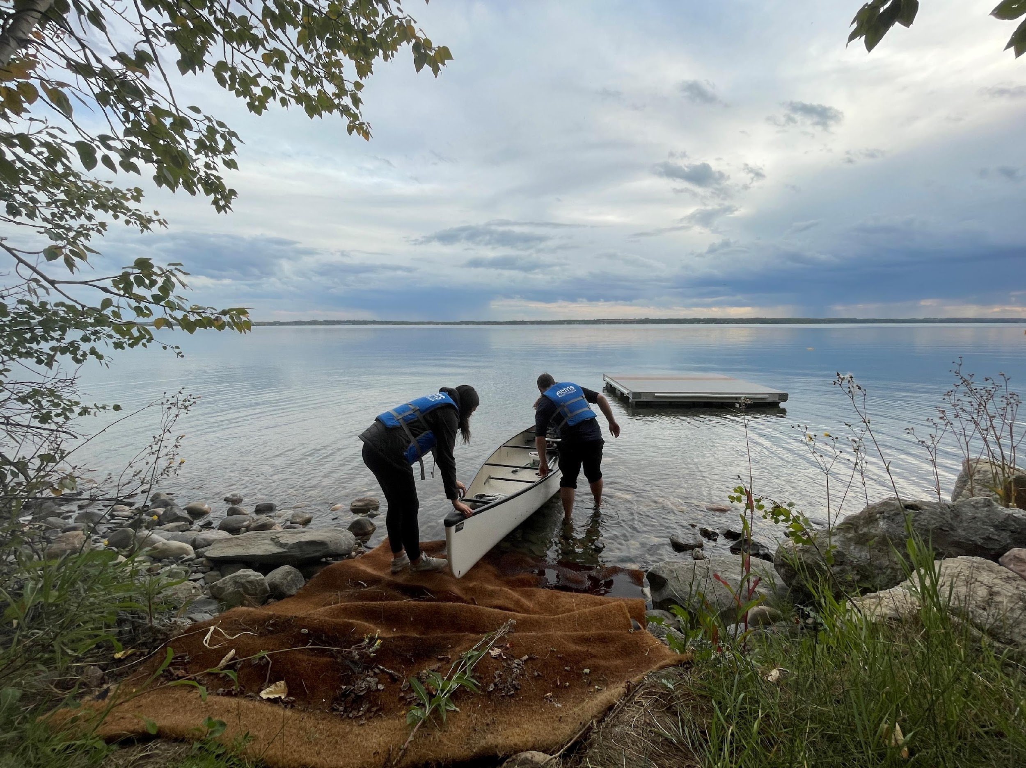
ALMS and Alberta Water Council
ALMS represents the Lake Conservation Sector on Alberta Water Council.
Jay White: Vice President and Director
Steph Neufeld: Alternate Director
Contributions to:
Resources to Support Drought Management
Source Water Protection Phase 1
ALMS workshop attendees launching a canoe on Sylvan Lake.

Slide 10
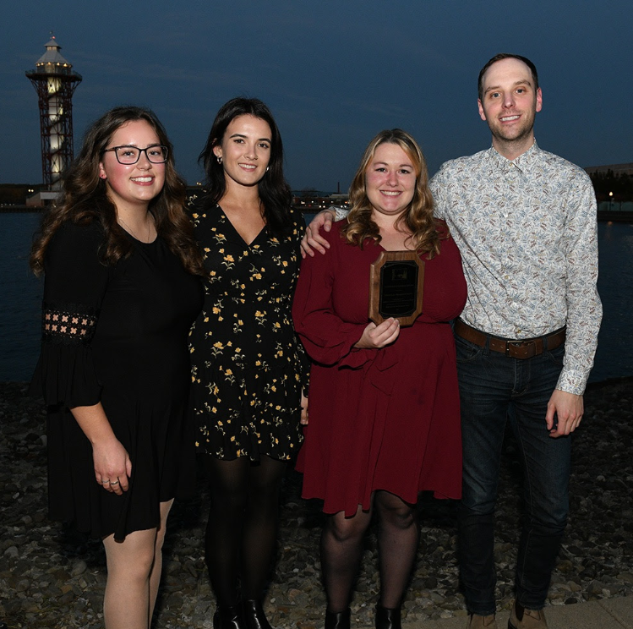
ALMS Receives 2023 Emerald Award for the LakeKeepers Program
ALMS Receives 2023 NALMS Leadership and Service Award

Slide 11
ALMS receives a valued partner certificate from Kehewin Cree Nation

Slide 12
ALMS in the Media
Emerald Documentary Featuring the LakeKeepers Program.
Interview on the “What on EARTH Are We Doing?” podcast. (Available on Spotify & Apple Podcasts!)
Interview on the “In Over My Head” podcast. (Also available on Spotify & Apple!)

Slide 13
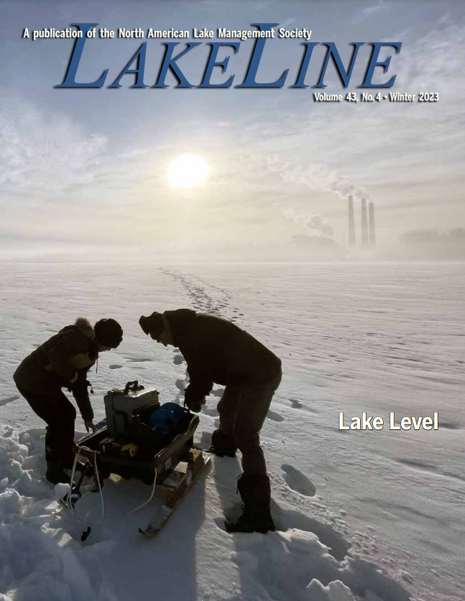
Award Winner NALMS Members Choice 2023 Photo Contest
Sue Styles and Neil Fleming of the Wabamun Watershed Management Council sampling Wabamun Lake as part of LakeKeepers
Winning photo featured on the cover of Volume 43 of the LakeLine Publication.

Slide 14
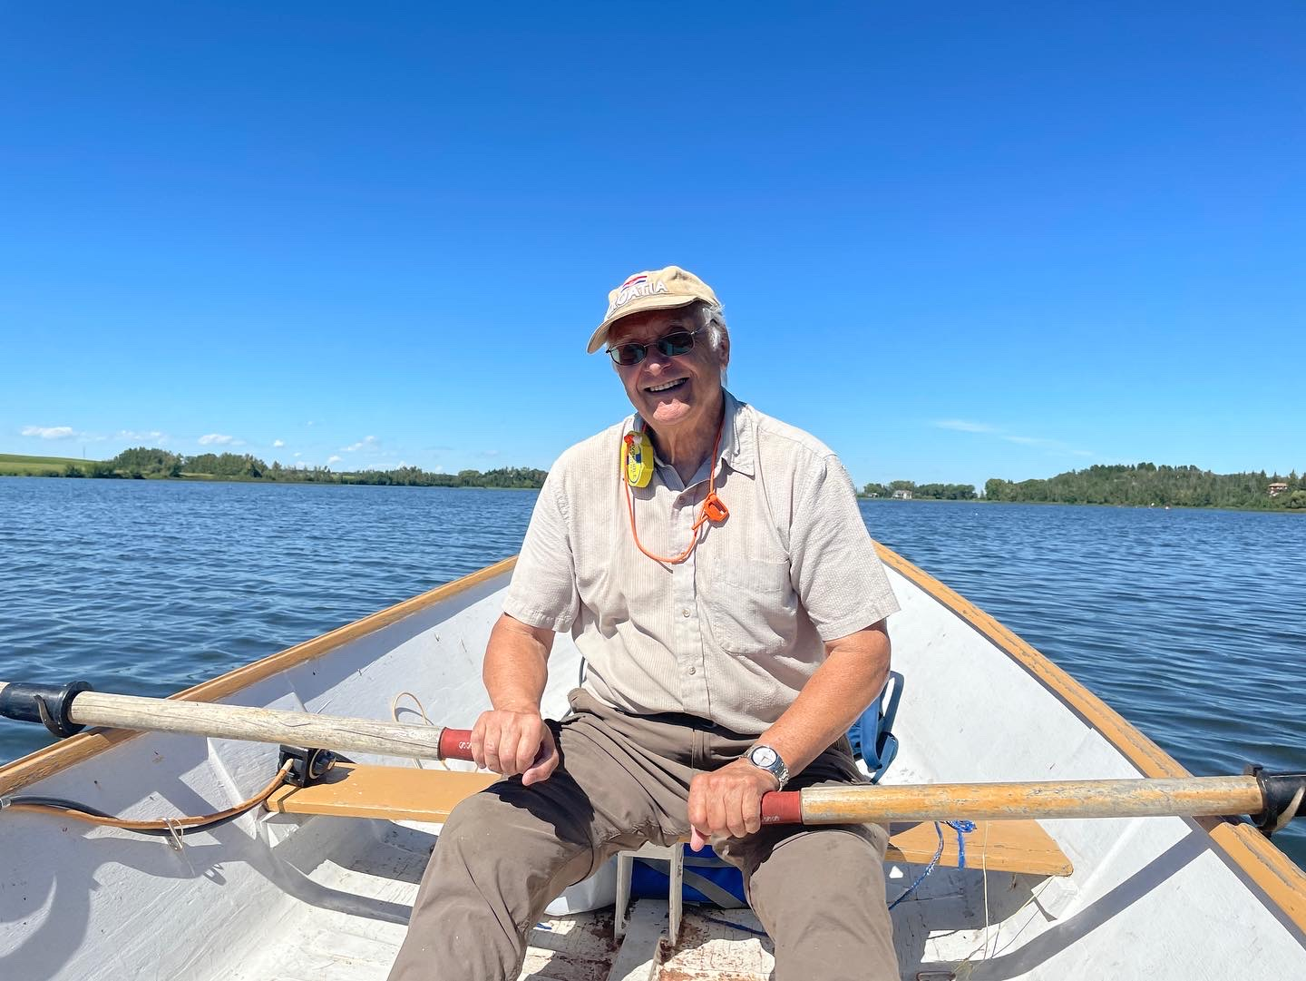
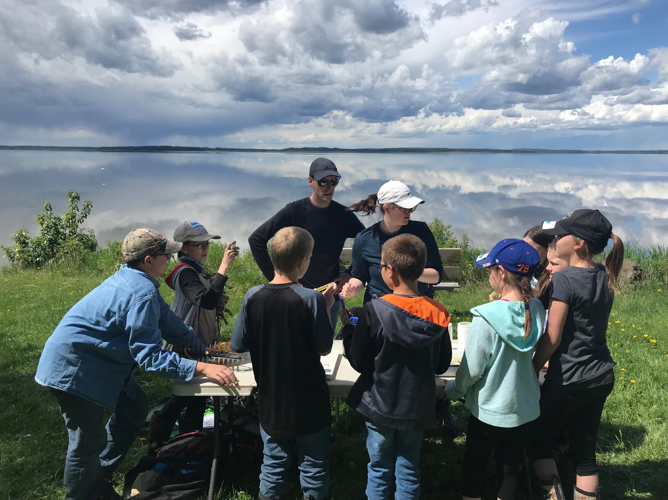
Communications and Outreach
Lacombe Lake Aquatic Plant Bioblitz.
Shoreline assessment for native and invasive aquatic plants.
98 plant specimens identified.
No invasive aquatic plants detected.
Cliff Soper from Lacombe Lake participating in a bioblitz for aquatic plants.
Volunteer Cliff Soper paddling ALMS staff across Lacombe Lake for the Lacombe Lake aquatic plant bioblitz event.

Slide 15
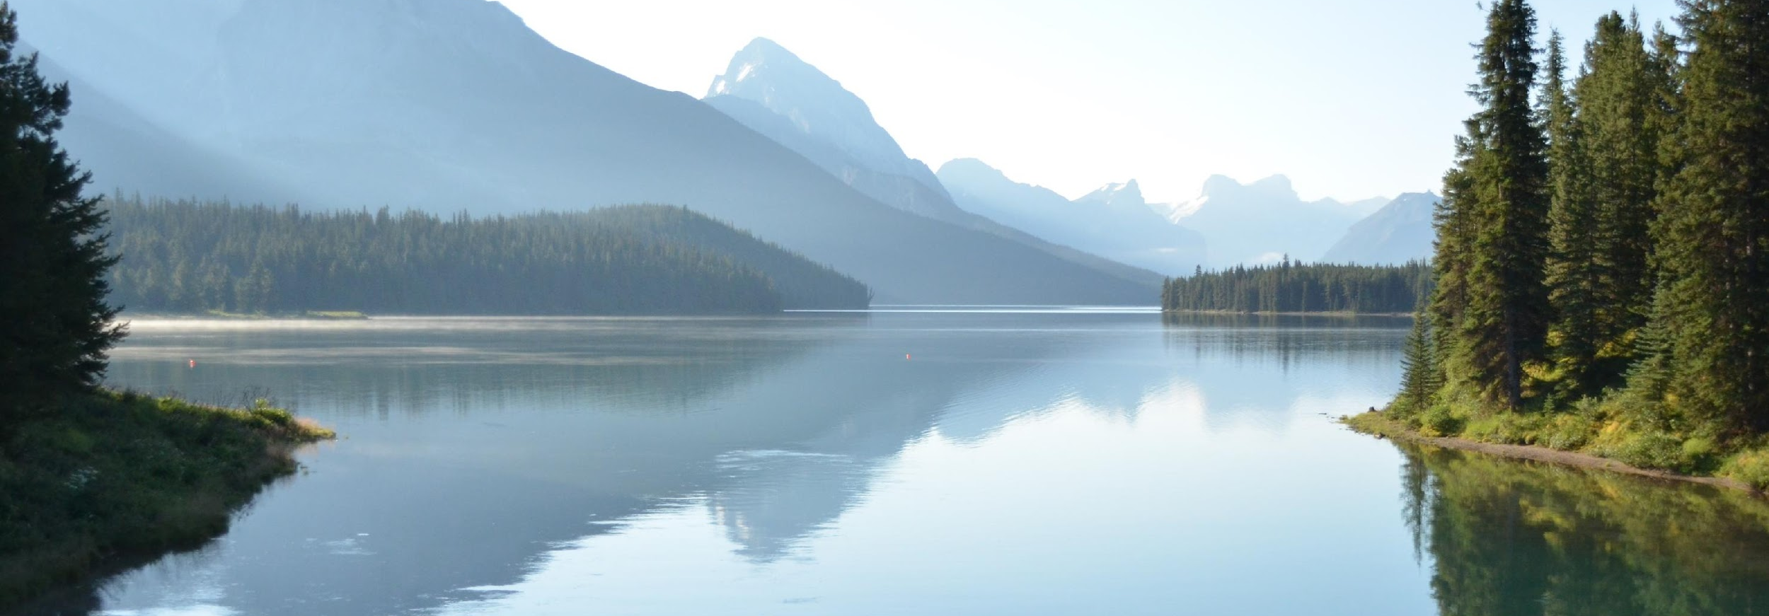
Strategic Objective Quality Programs
ALMS is a leader in Citizen Science and Community Based Monitoring
ALMS programs are accessible to Indigenous Communities
ALMS supports research in the Aquatic Sciences
ALMS supports Lake Stewardship
Supporting lake management in Alberta

Slide 16
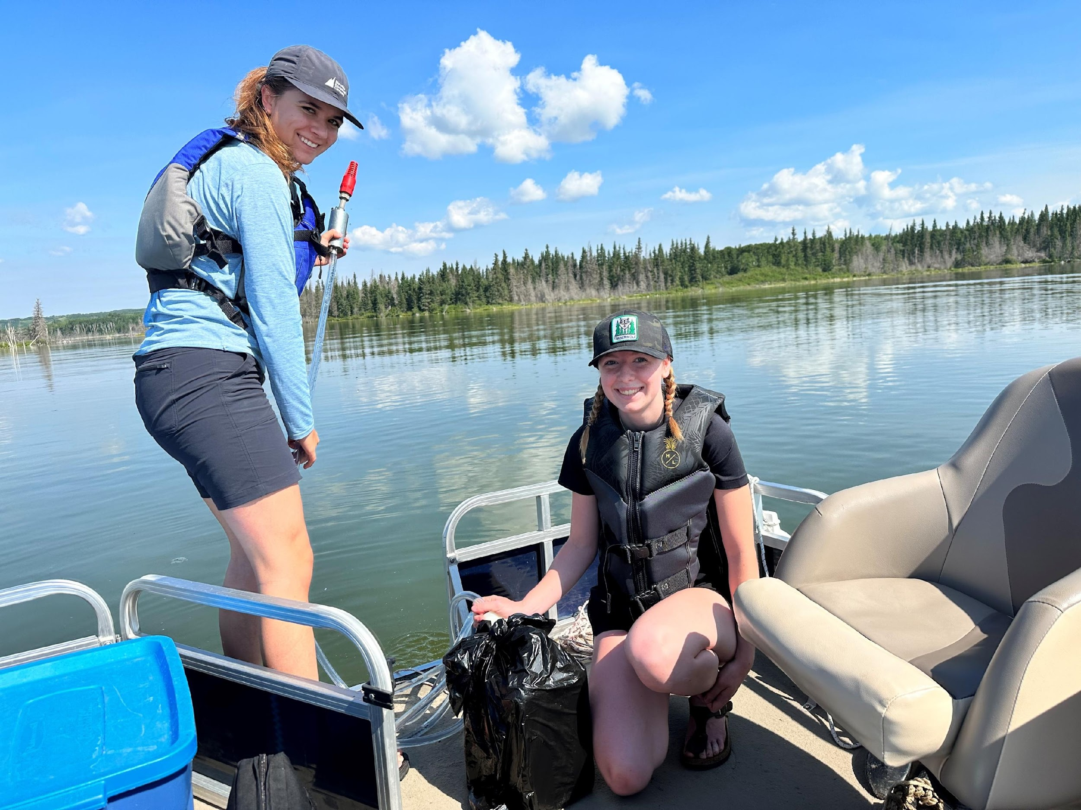
105 Sampling Events
Challenges with drought on reservoirs.
27 Unique Lakes
348 Volunteer Hours
COMMUNITY BASED MONITORING OF ALBERTA’S LAKES FOR NEARLY 30 YEARS
ALMS technician Maddie Koning sampling Laurier Lake.

Slide 17
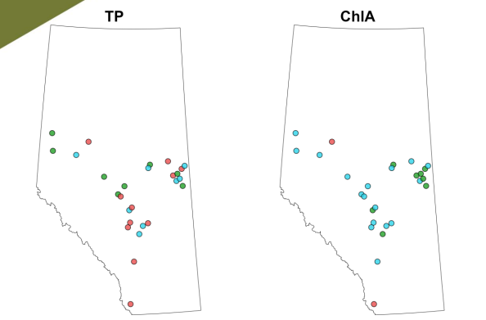
Decreasing (red), increasing (green), and no trends (blue) detected at lakes with more than 10 years of data.
See Annual Trend Summary at www.alms.ca/reports
Total phosphorus and chlorophyll-a trends detected at Alberta Lakes.

Slide 18
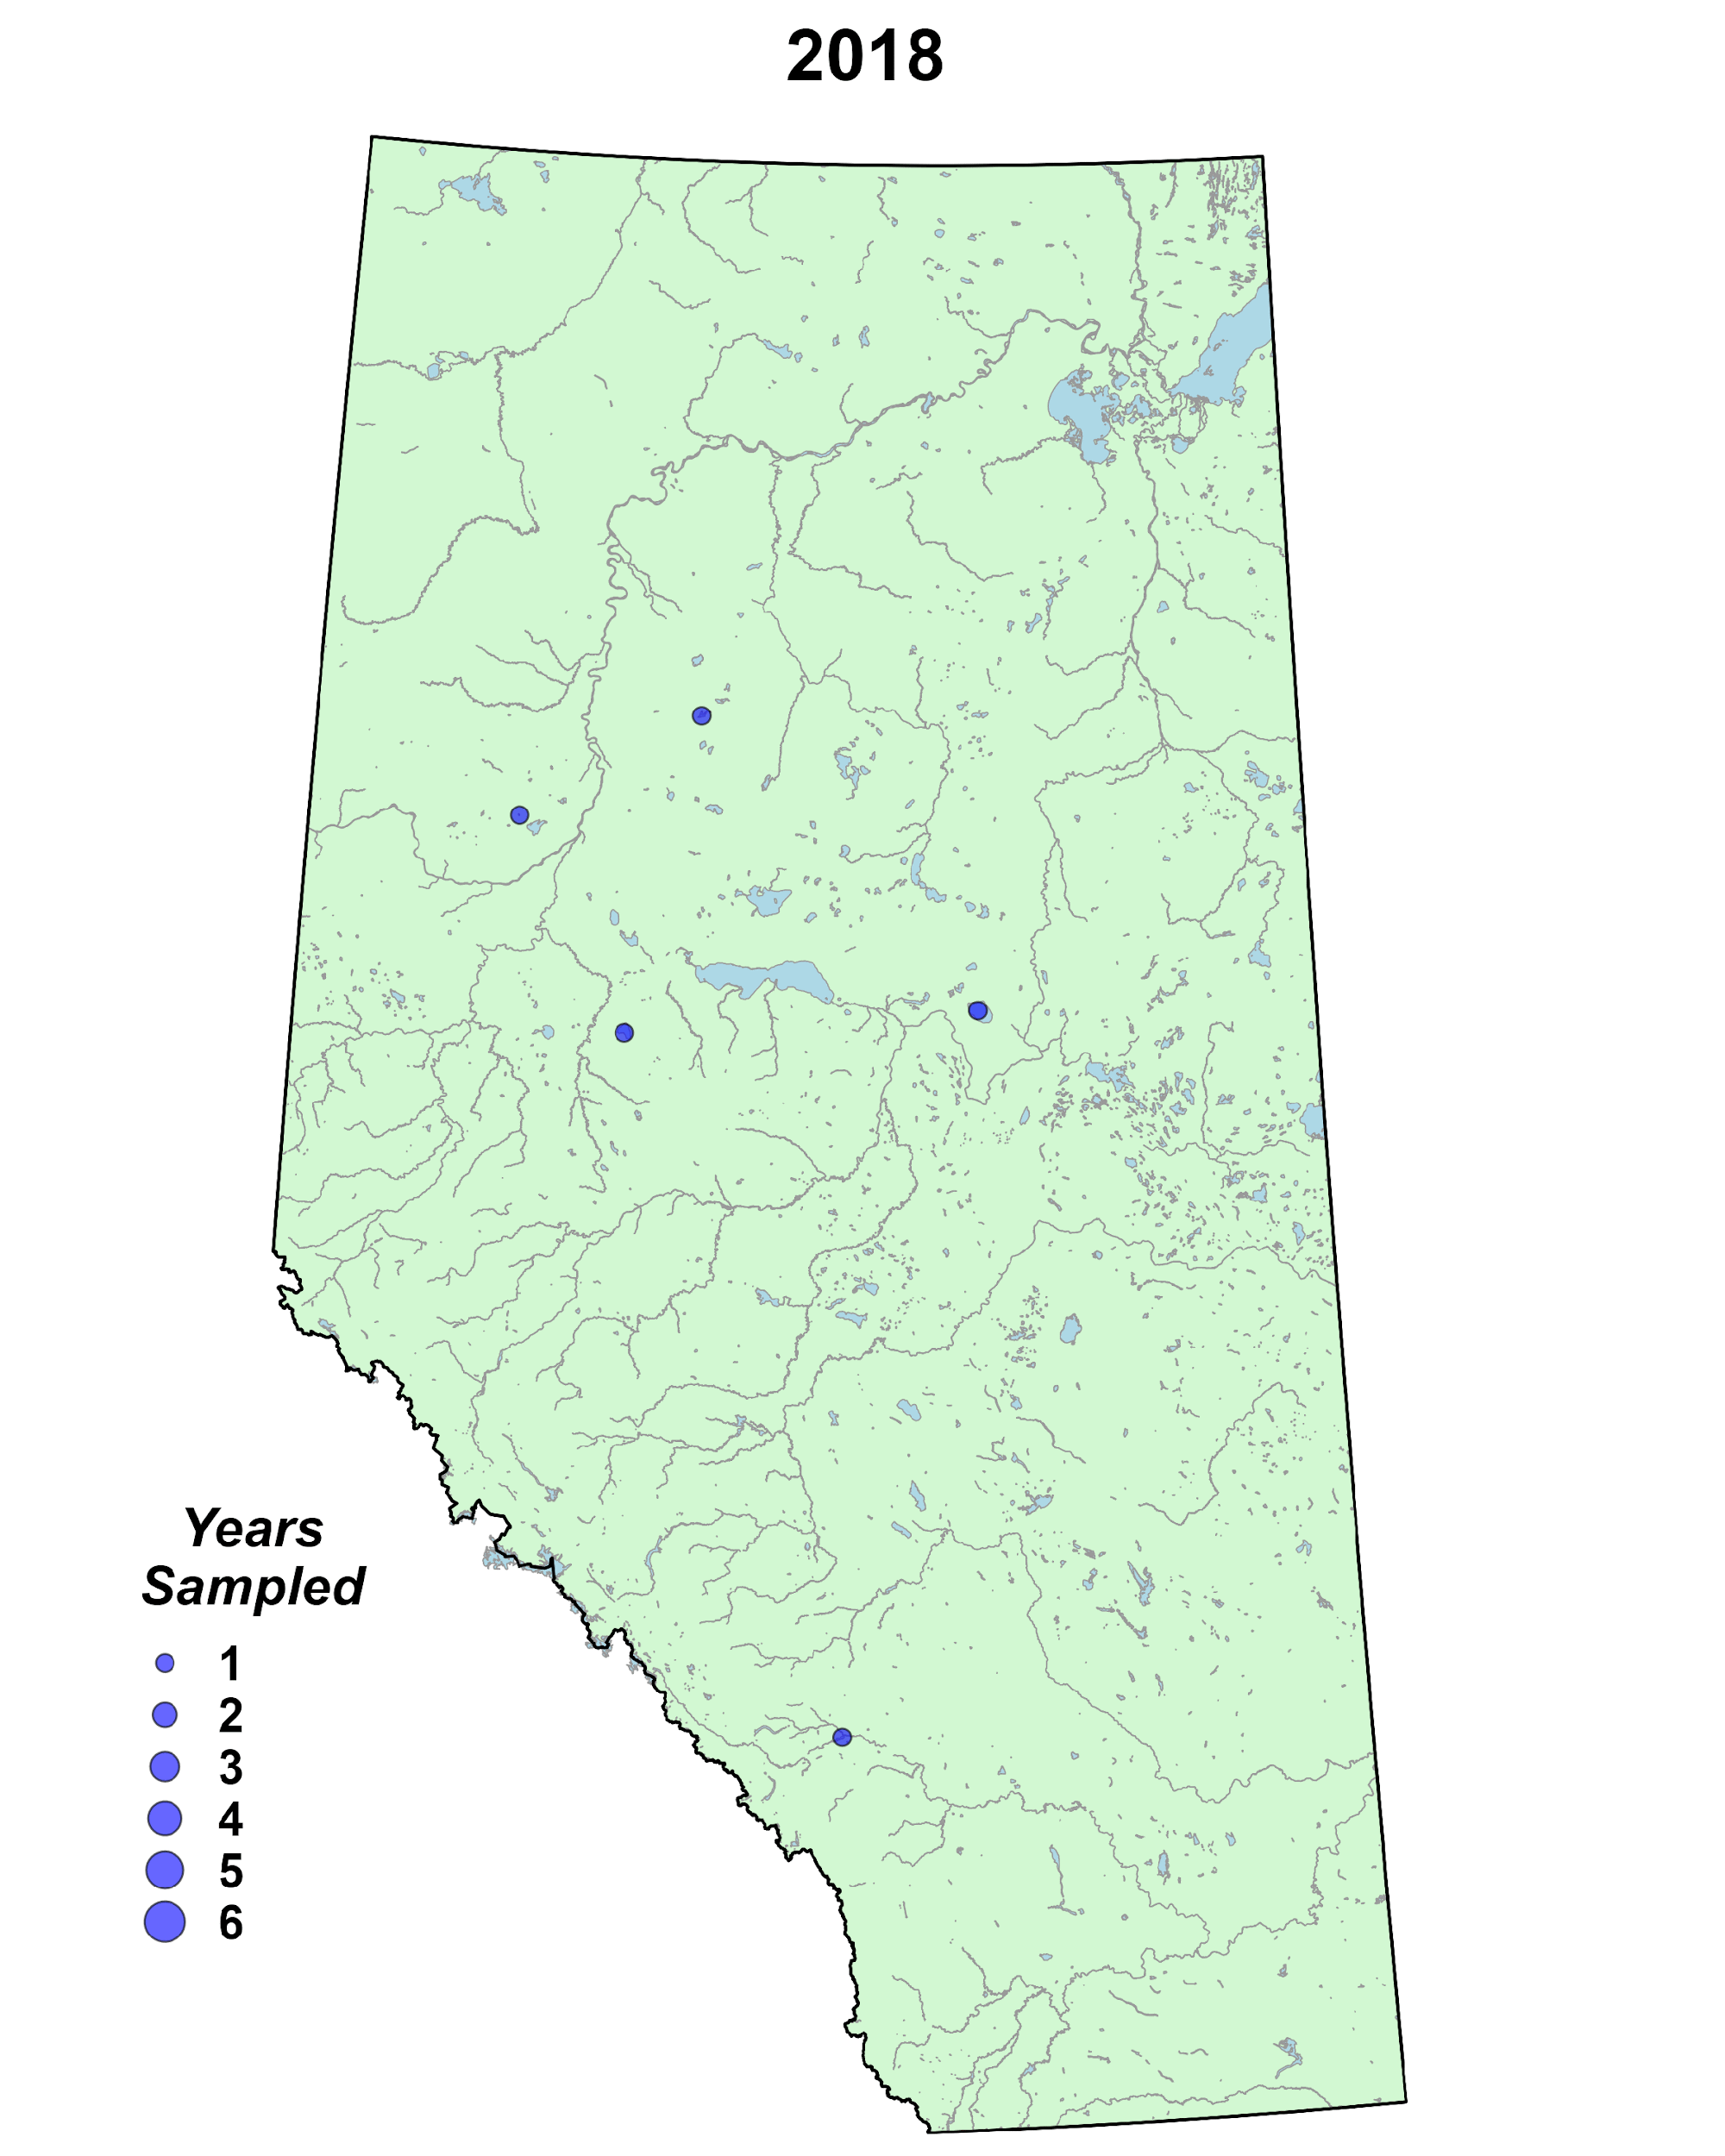
Traditional citizen science program.
Volunteers trained and equipped to collect data.
Designed to support remote and under-sampled waterbodies.
A TRADITIONAL CITIZEN SCIENCE APPROACH TO TRACKING WATER QUALITY
Animated GIF of sampling sites and frequency since 2018.

Slide 19
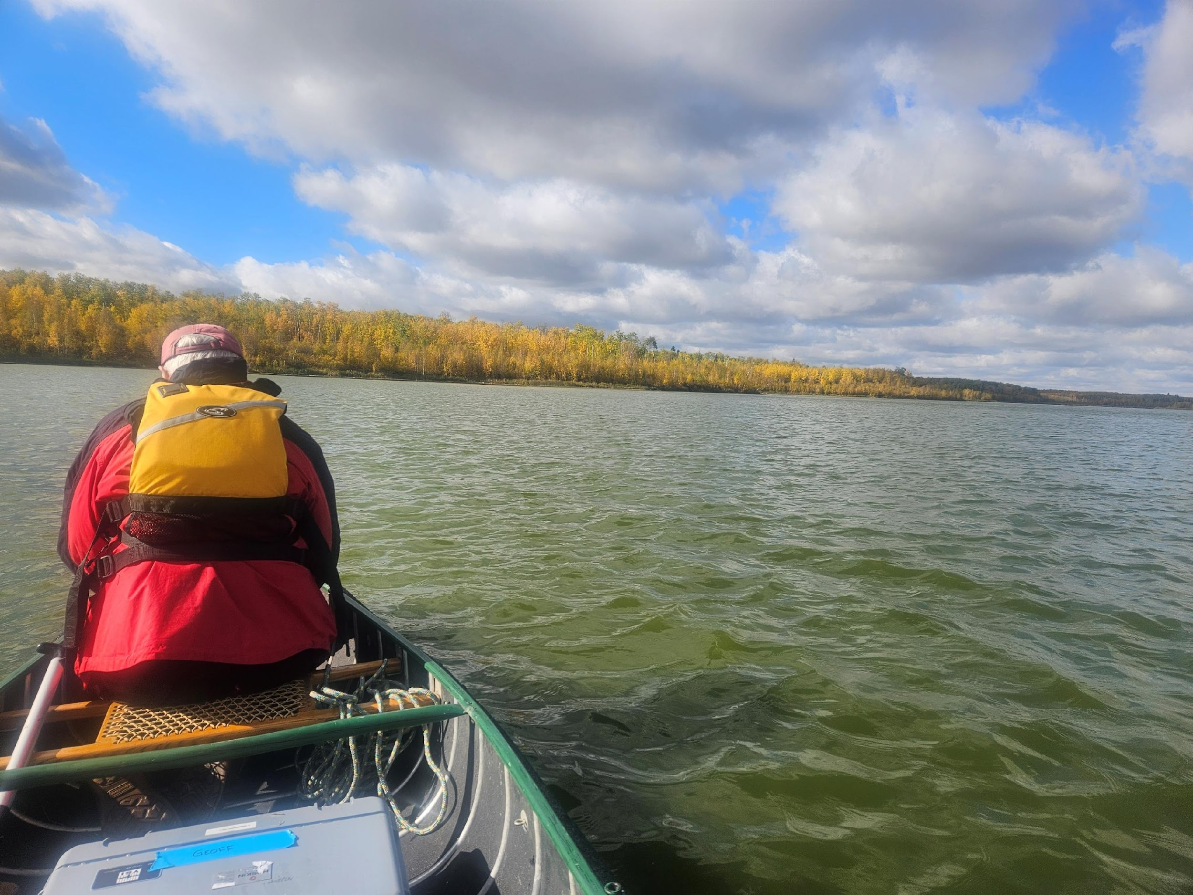
Summer LakeKeepers
Focus on remote and under-sampled waterbodies.
17 lakes samples
47 Monitoring Trips
Key partnerships with Mighty Peace Watershed Alliance, Mackenzie County, Kehewin Cree Nation, Mountain Métis, Alberta Conservation Association, and others.
LakeKeepers Volunteer Geoff Holroyd sampling Islet Lake.

Slide 20
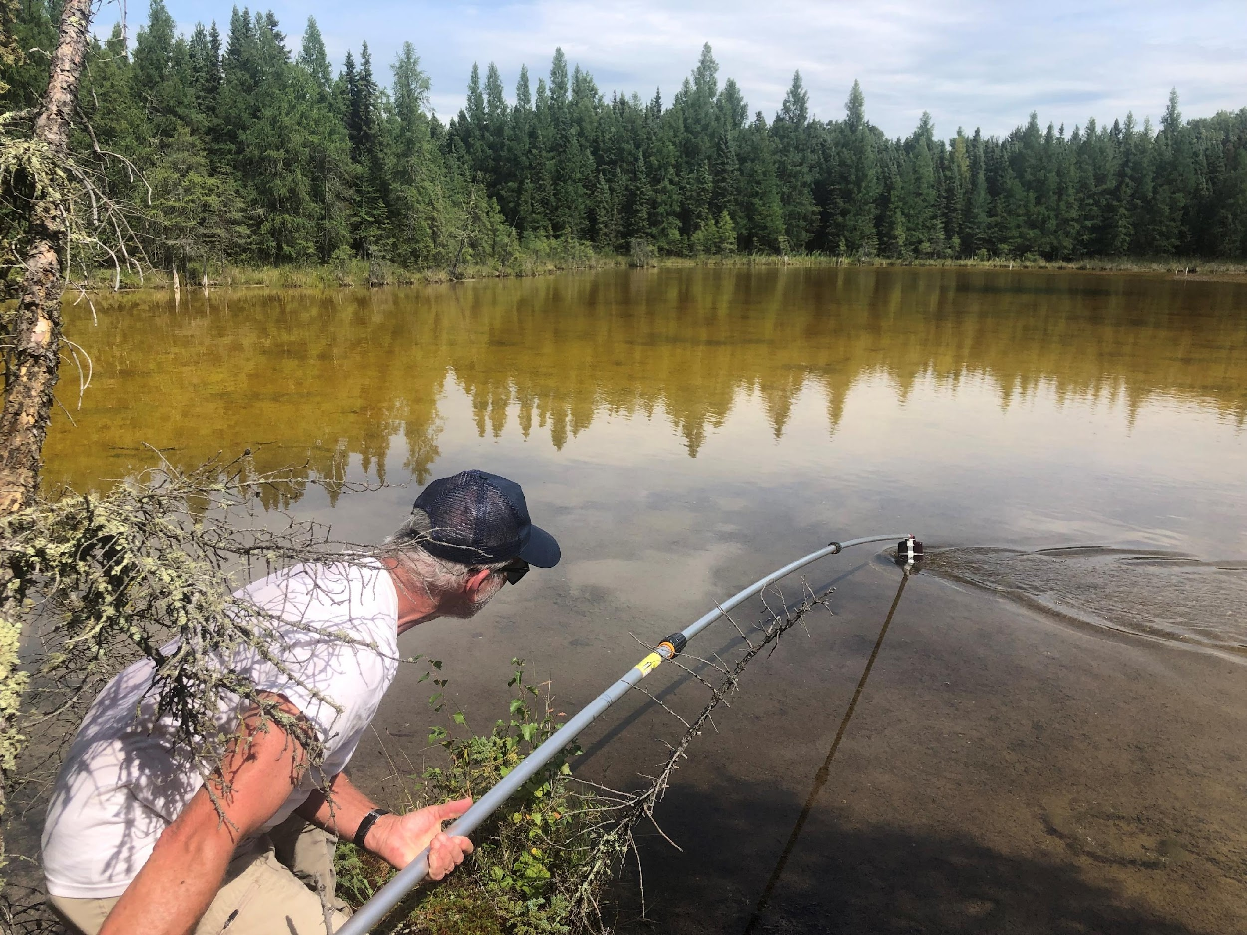
Lakes of the Carvel Pitted Delta Project
In 2023, an additional 27 unique lakes sampled by a small group of volunteers of the Matayan Lake Management Association.
Nearly 100 unique lakes sampled to date.
Revealing an incredible collection of high quality lake resources.
Dave Mussel sampling lakes in the Carvel Pitted Delta.

Slide 21
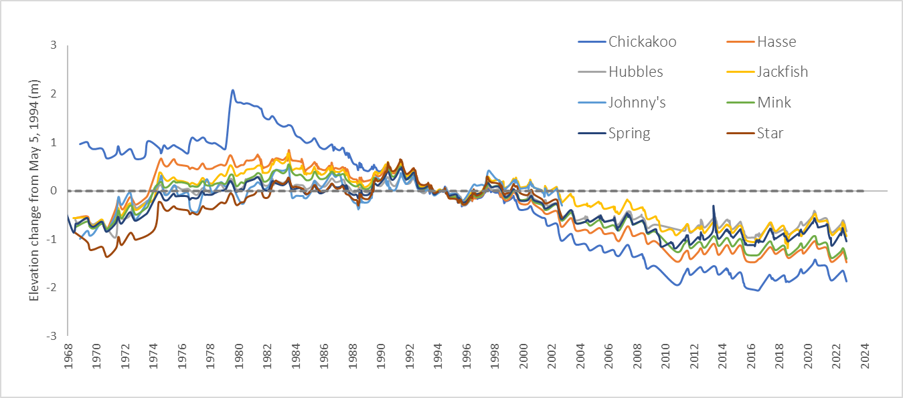
Data available at www.alms.ca/reports.
Drone and underwater footage available on Youtube.
Wide range of water quality conditions unique geological region.
Changes in water levels observed at 8 named lakes in the Carvel Pitted Delta region.

Slide 22
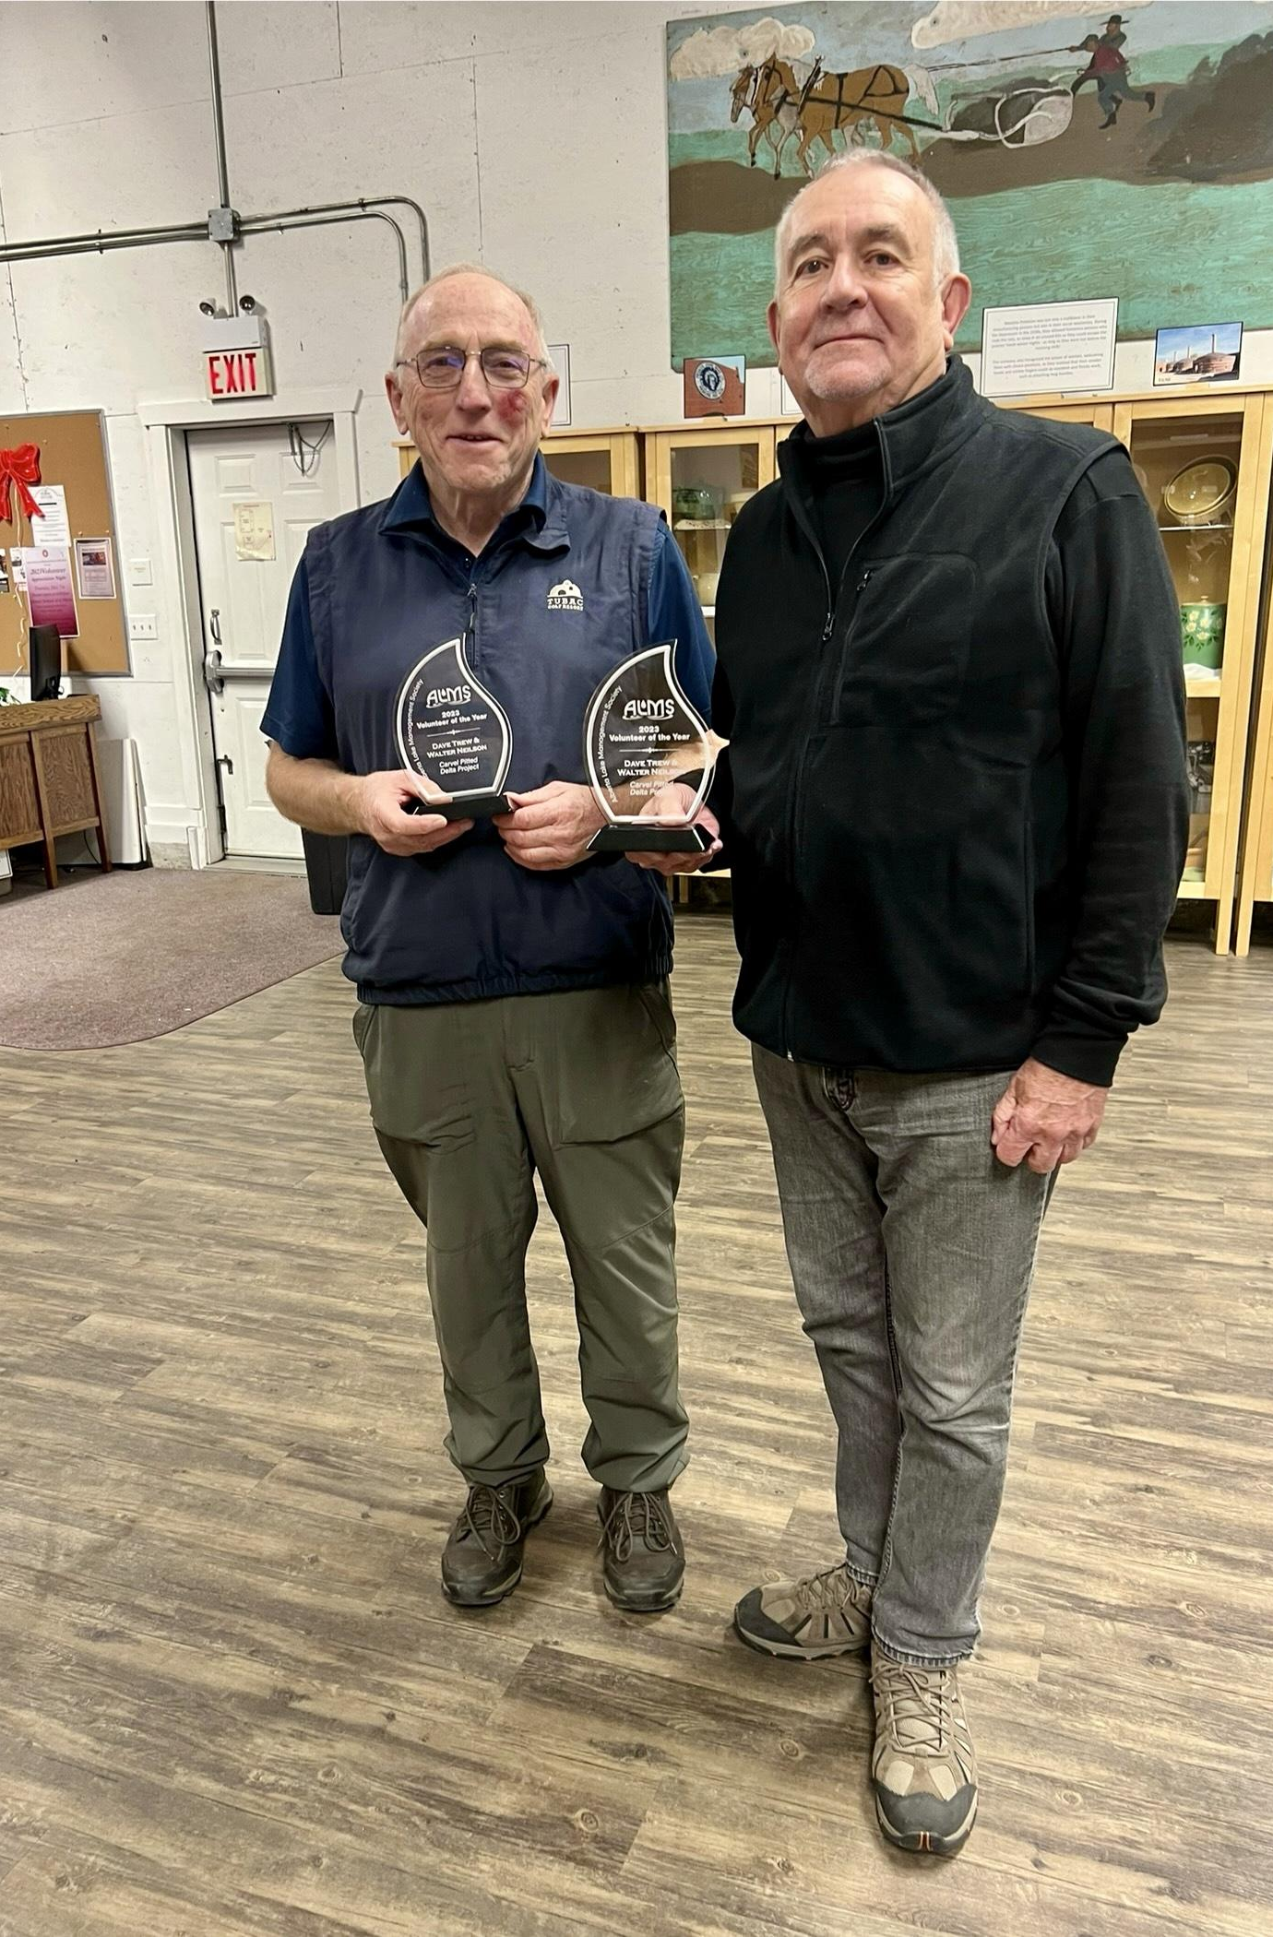
2023 Volunteer of the Year Award
Awarded to Walter Neilson and David Trew of the Mayatan Lake Management Association for outstanding contributions to and elevations of ALMS programs.
Photo (left to right): Walter Neilson, David Trew.

Slide 23
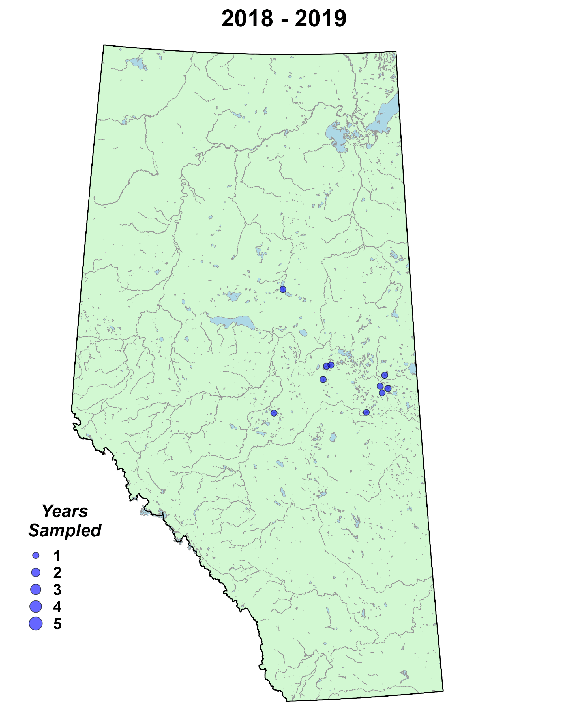
Winter LakeKeepers
The most significant effort to understand winter lakes in Alberta.
Training and equipping citizen scientists and winter anglers to monitor Alberta’s lakes.

Slide 24
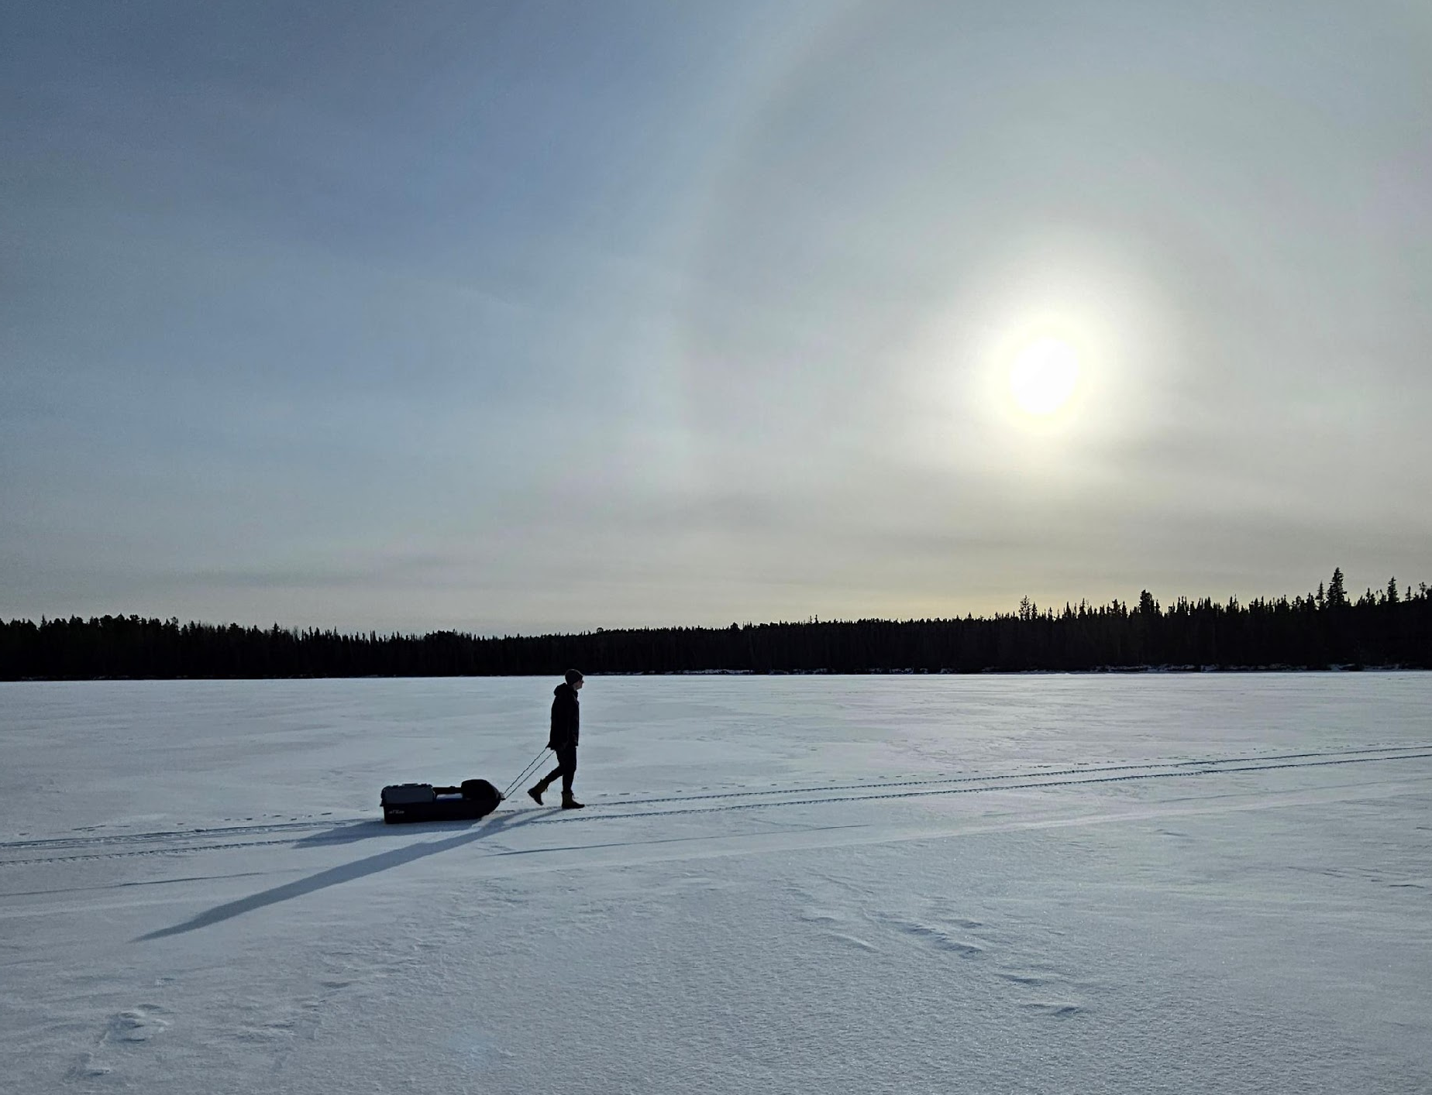
Winter
111 monitoring events
57 Waterbodies
643 volunteer hours
EXPANDING OUR UNDERSTANDING OF LAKES THROUGH CITIZEN SCIENCE
LakeKeepers volunteer Joey Pyper trekking across Obed Lake.

Slide 25
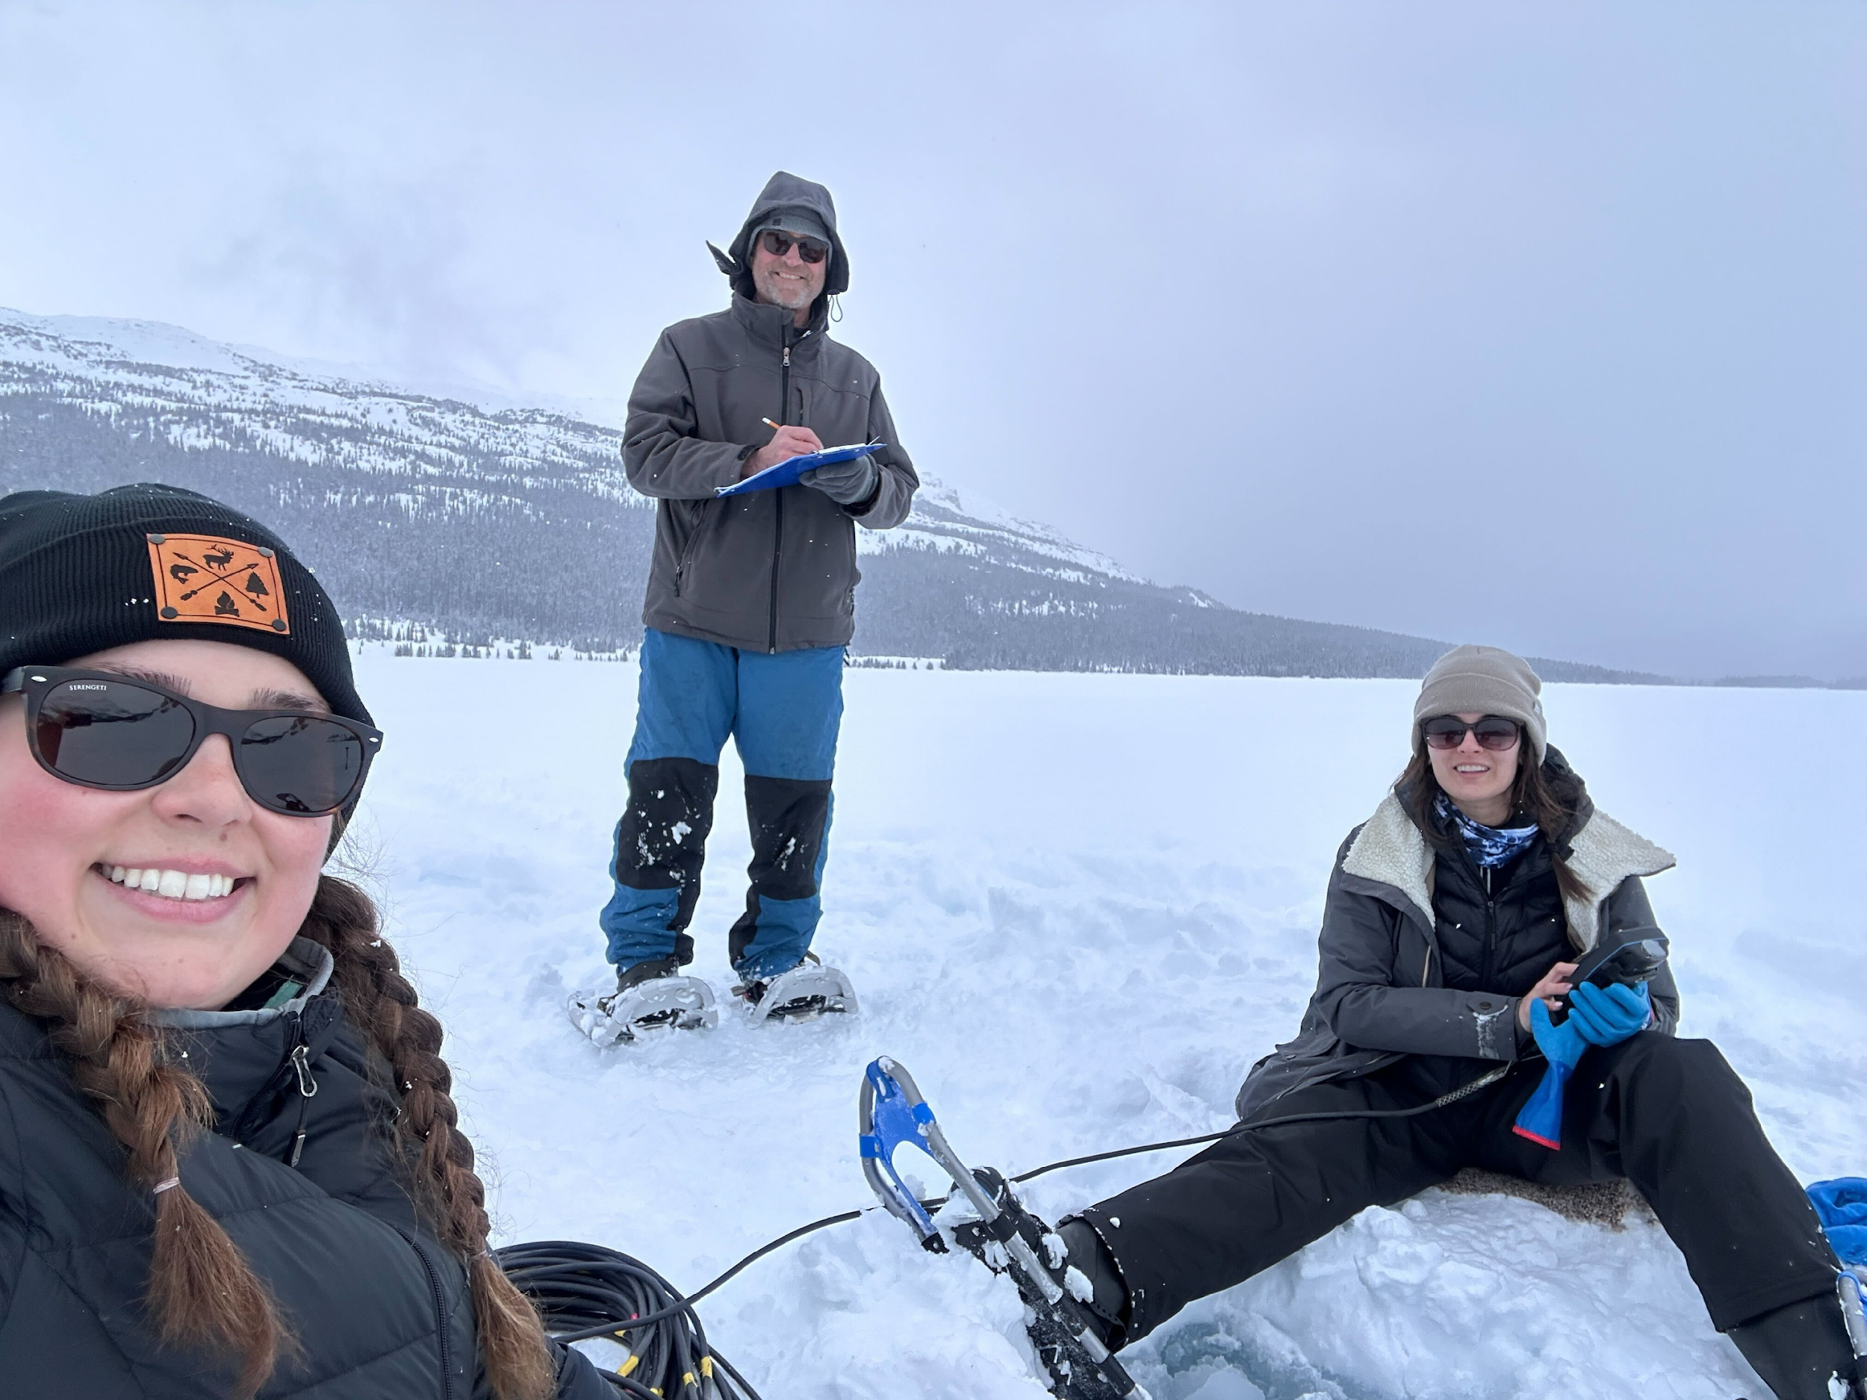
Winter
643 Volunteer Hours
60 Waterbodies
77 unique waterbodies
THE LARGEST DATA COLLECTION ON ALBERTA’S WINTER LAKES
Wendell Koning and ALMS staff collecting samples at Bow Lake in Banff National Park.

Slide 26
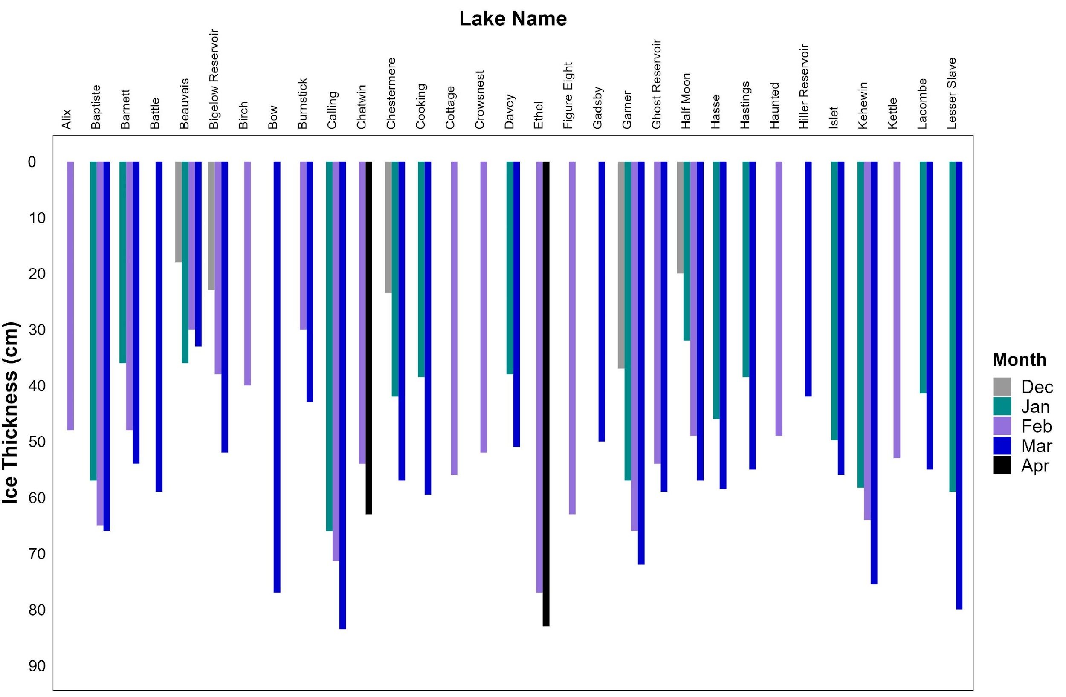
Winter
Reporting on ice thickness, nutrients, chloride, temperature, oxygen, snow cover, and more.
Tracking winter ice thickness from December through April.

Slide 27
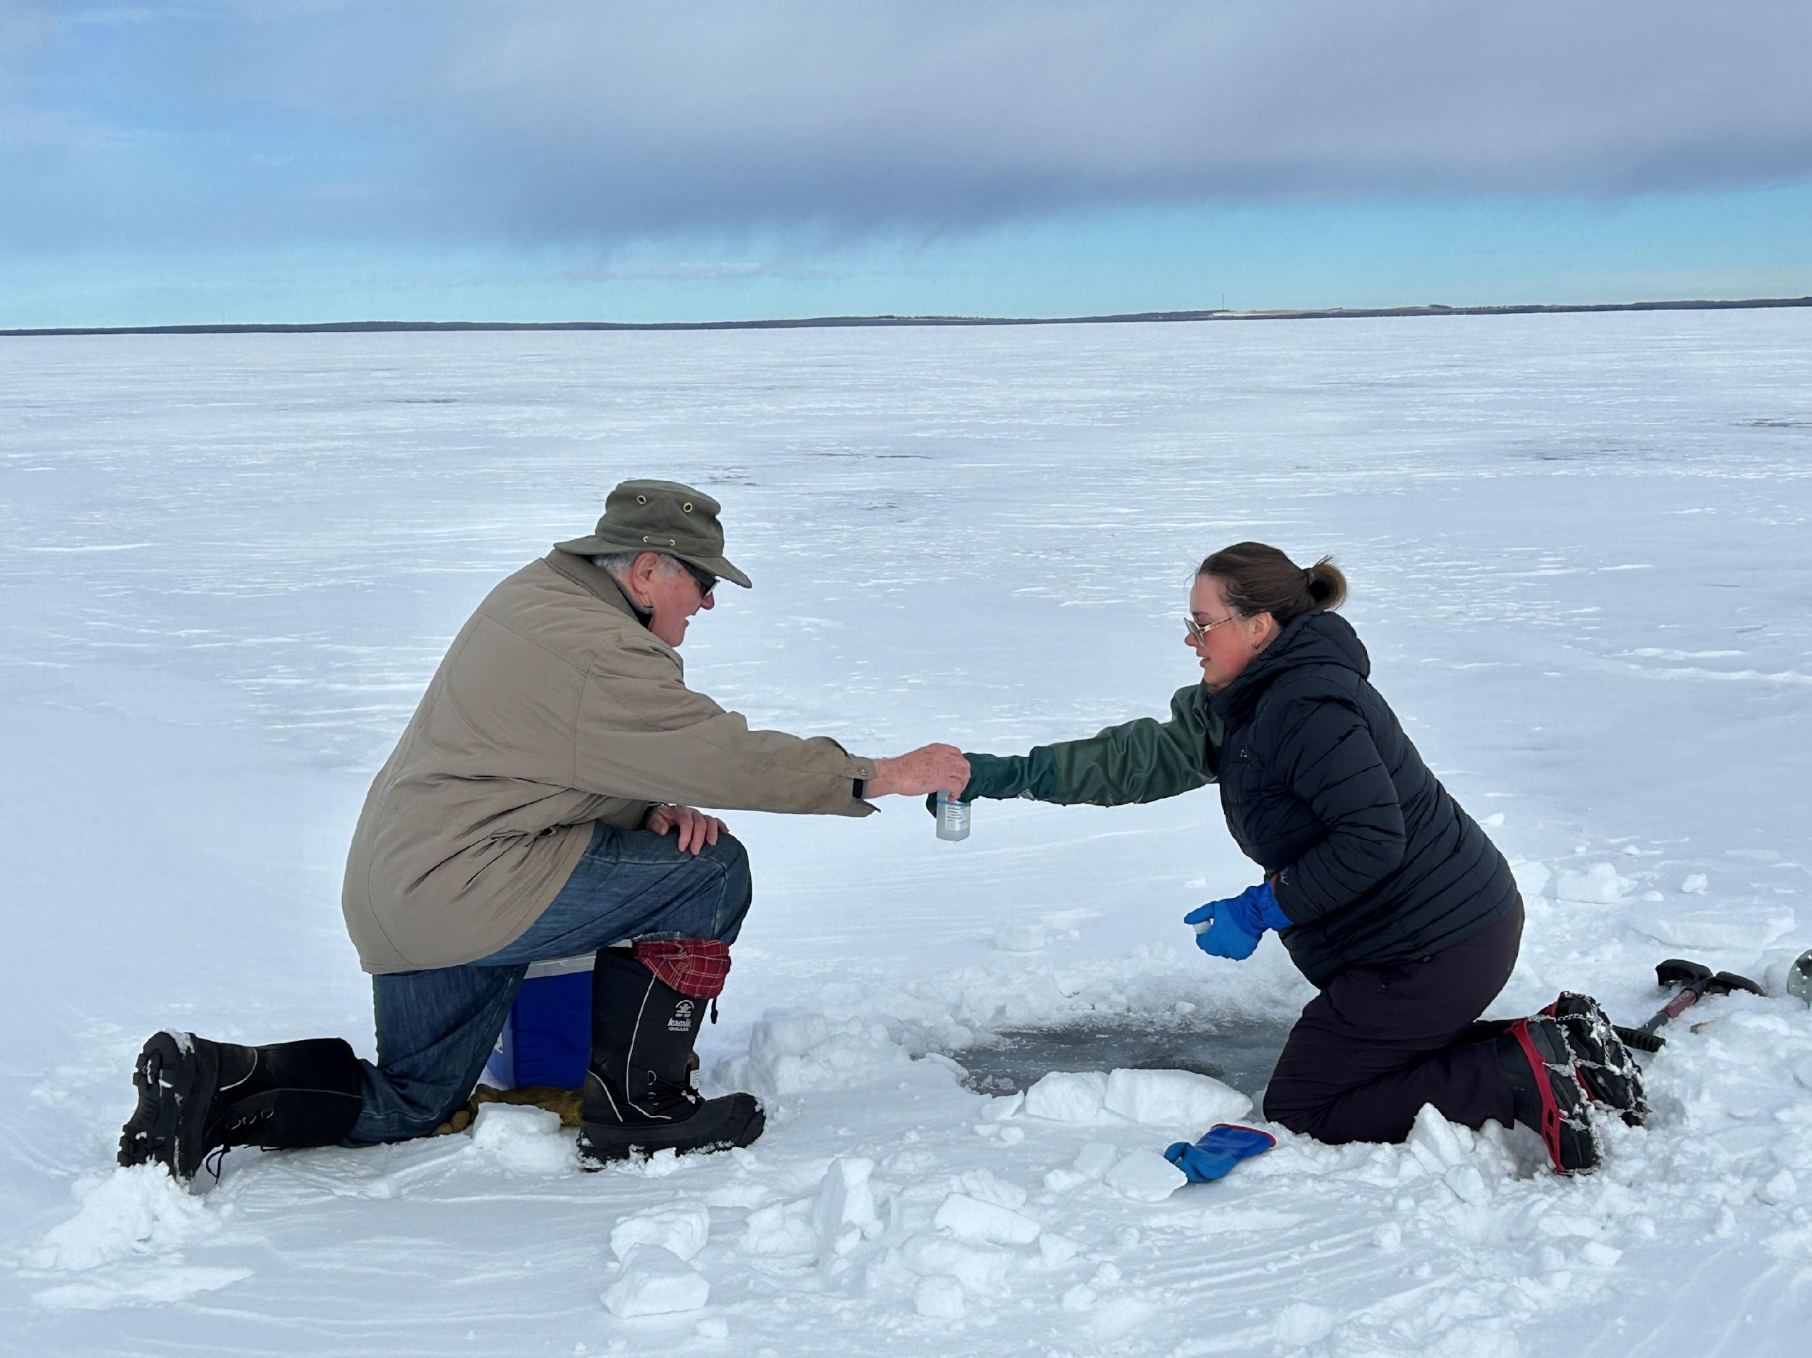
Pigeon Lake High Frequency Sensor
High frequency buoy installed January 2024 to April 2024.
30 minute dissolved oxygen and temperature readings at 3 depths.
Data being analyzed by University of Calgary undergraduate student.
Don Davidson and Kirsten Letendre collecting samples at Pigeon Lake.

Slide 28
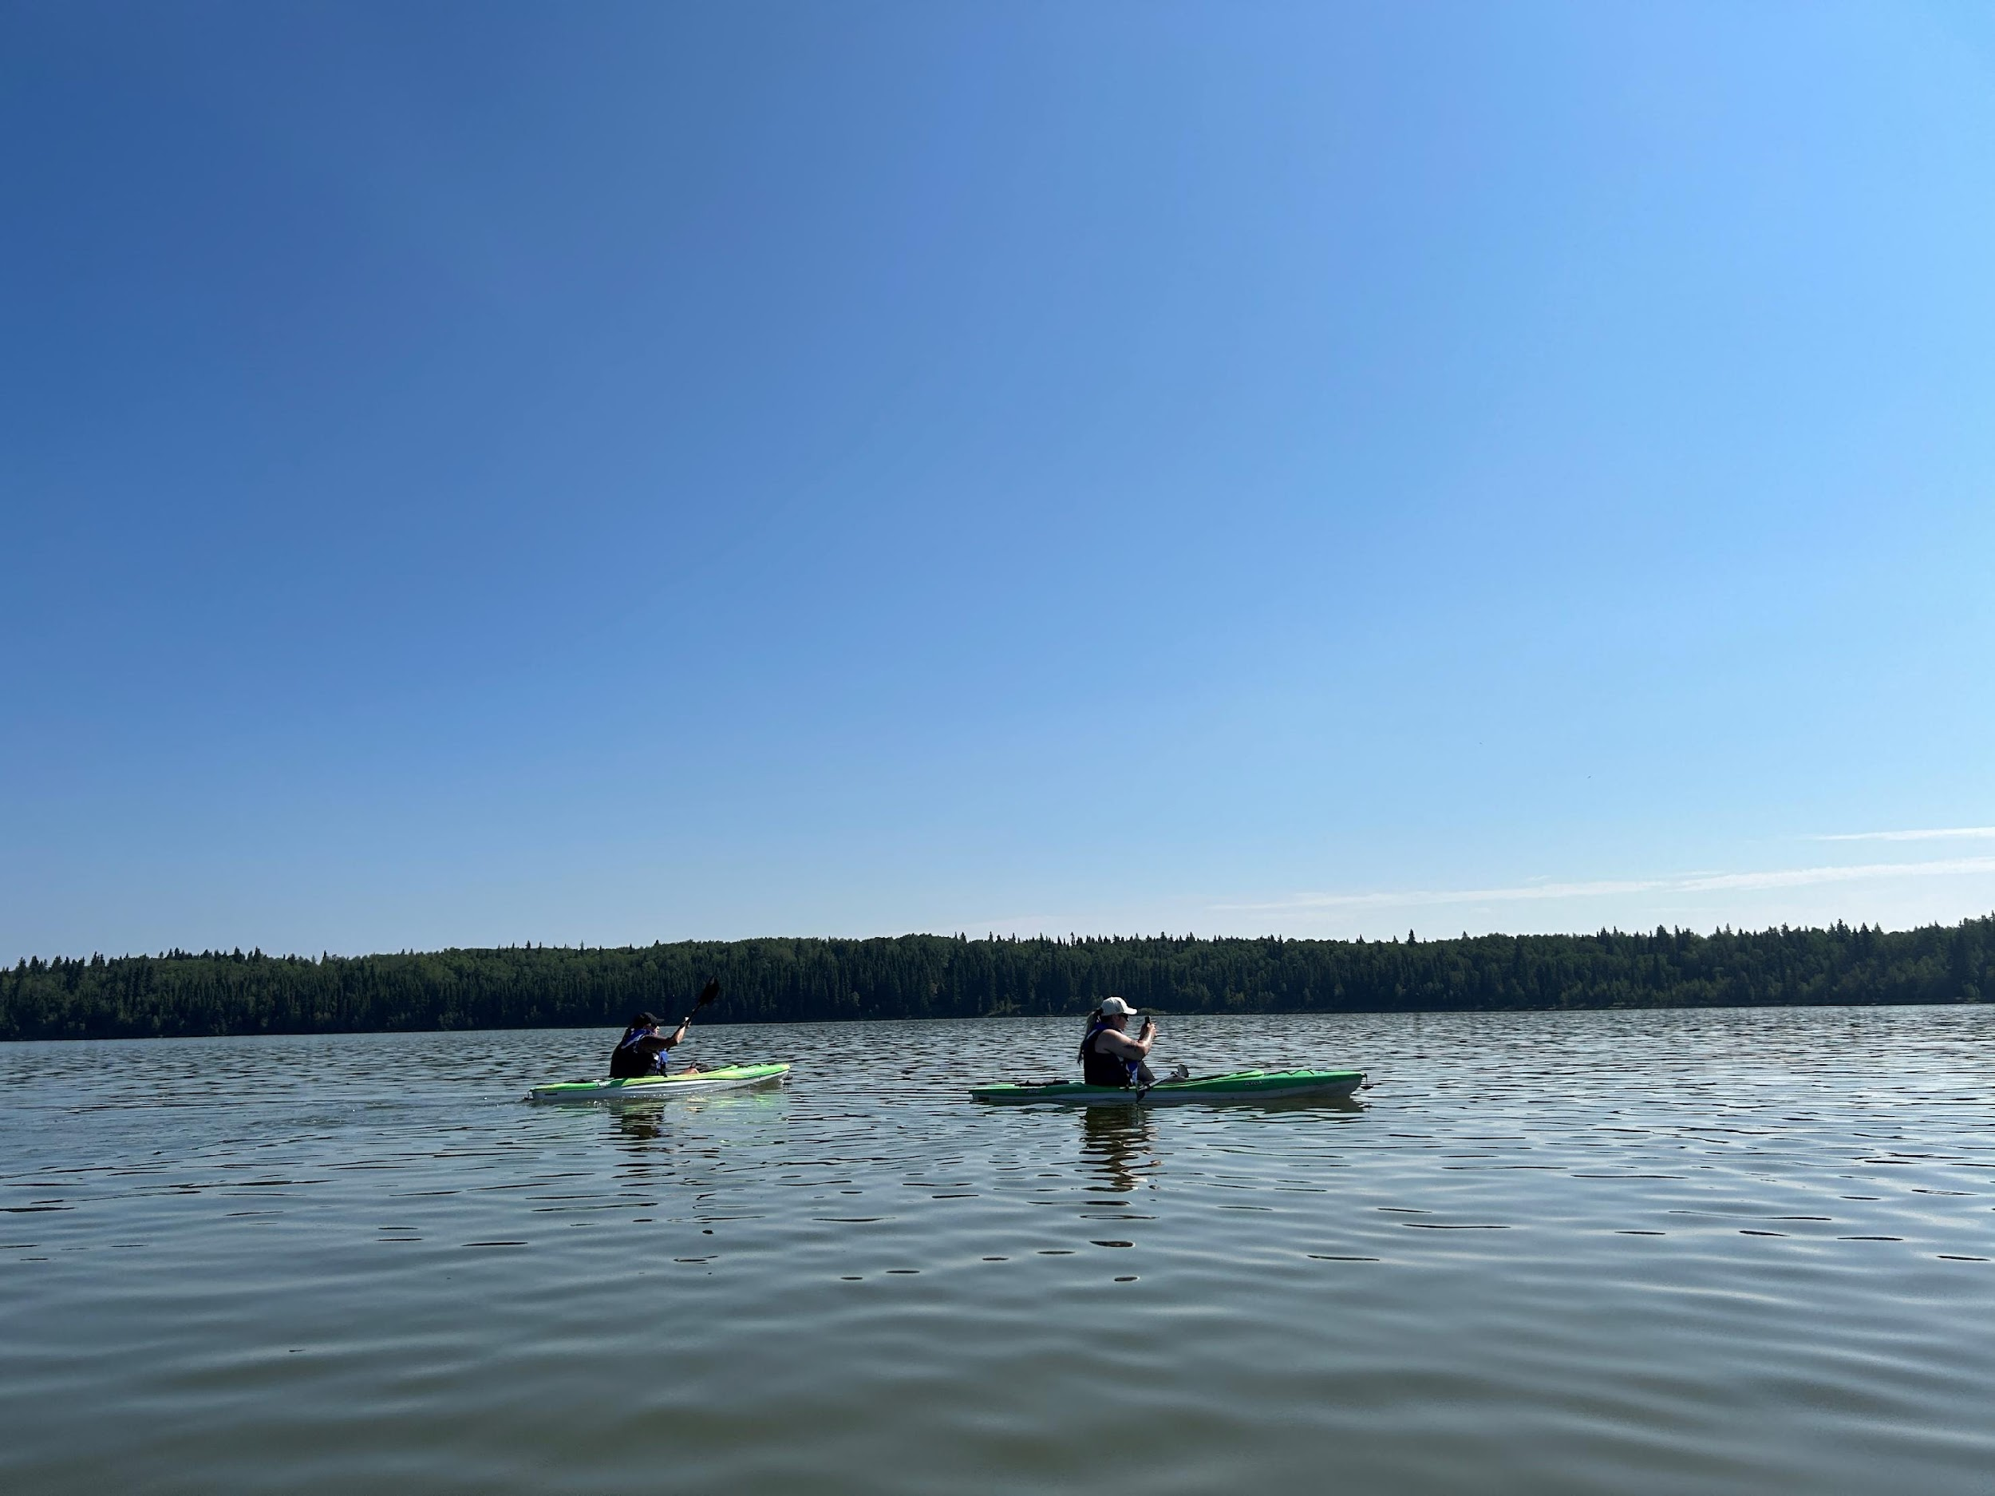
Supporting 8 Indigenous Communities in Alberta’s Oil Sands Region with year round lake monitoring.
Enhanced monitoring for industrial pollutants.
Field visits to every community.
MONITORING ALBERTA’S LAKES IN THE OIL SANDS REGION
Environmental Monitors from Peavine Métis Settlement monitoring Pelican Lake.

Slide 29
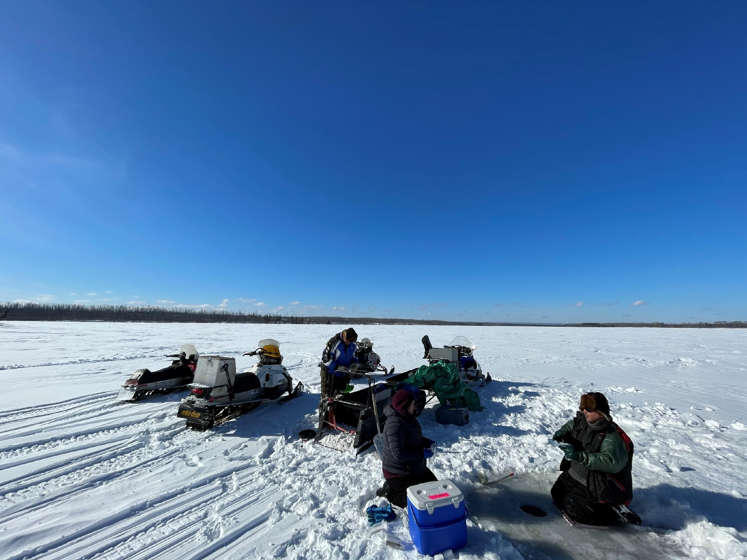
Communities equipped and trained with monitoring gear.
Monitoring throughout winter season.
Data packages prepared for each participating community.
SUPPORTING INDIGENOUS COMMUNITIES IN ACHIEVING THEIR MONITORING OBJECTIVES
Sampling of Surmont Lake in the winter of 2024 through the ICBM program.

Slide 30
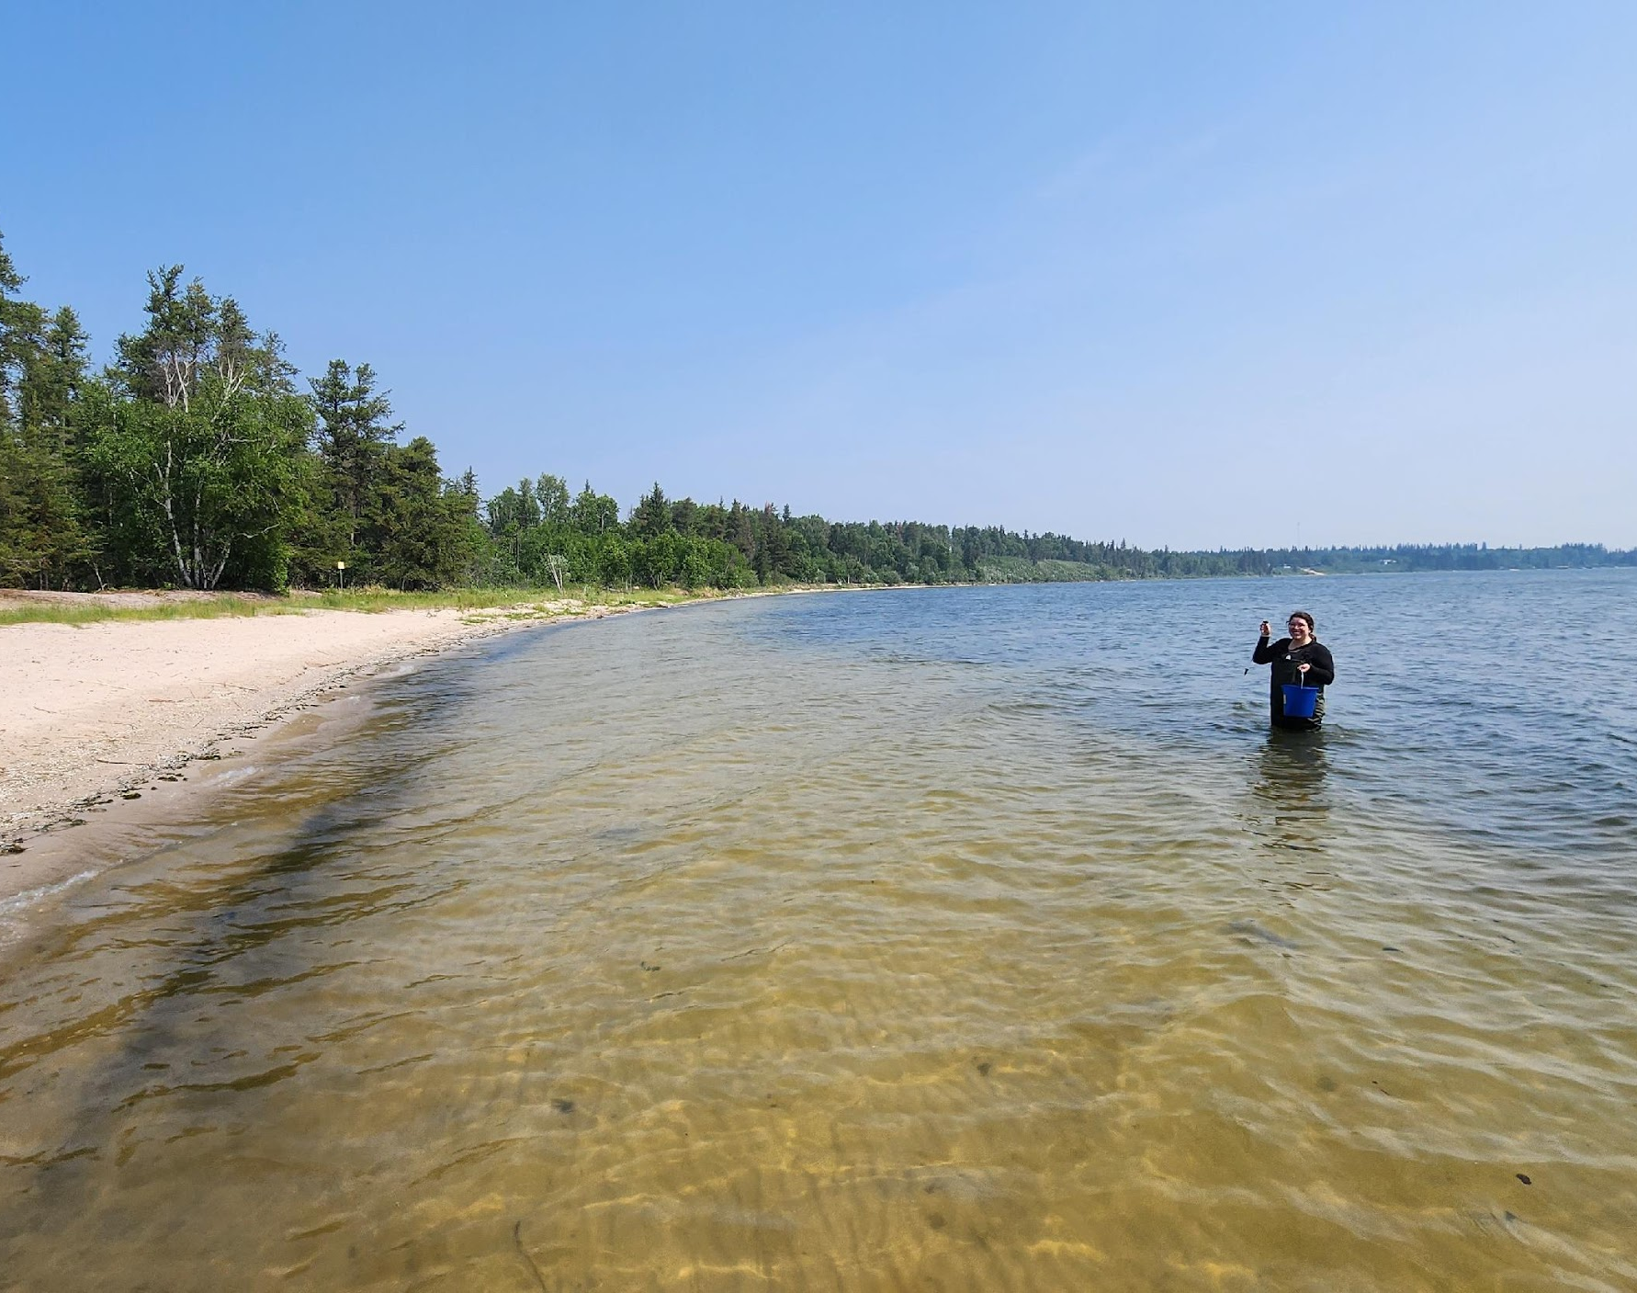
Recreational Beach Monitoring
272 public beach sampling events for enterococcus and/or cyanobacteria.
32 lakes monitored.
Enhanced monitoring for rare cyanobacterial toxins including anatoxin and cylindrospermopsin.
ACHIEVING PROVINCIAL RECREATIONAL MONITORING OBJECTIVES THROUGH ALMS.
Jordyn Lajeunesse monitoring for cyanobacteria and their toxins at Moose Lake.

Slide 31
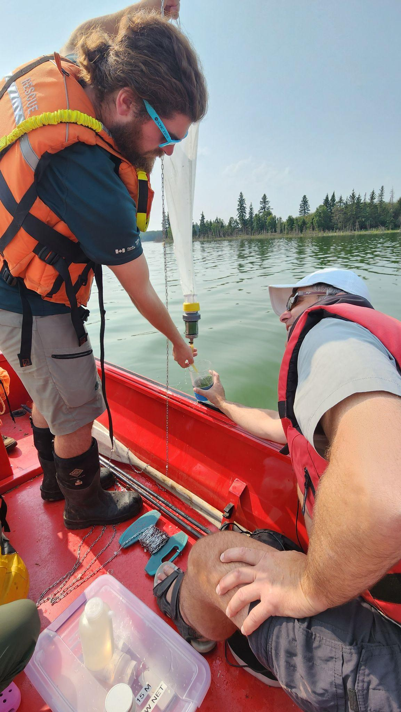
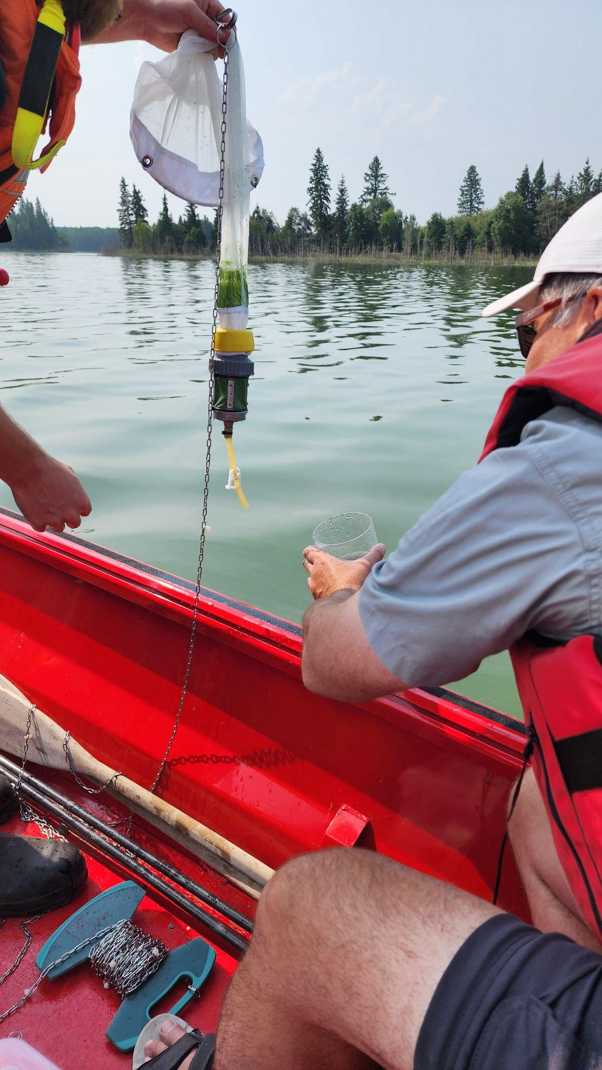
Invasive Species Monitoring
162 samples for Dreissenid mussels and spiny water flea collected from 27 lakes.
35 watermilfoil samples tested genetically for Eurasian watermilfoil.
133 aquatic plant samples collected from Lacombe Lake.
No aquatic invasive mussels detected in 2023.
Thank you to the Alberta Plant Health Lab for genetic testing support.
Collecting AIS from Elk Island National Park with Parks Staff.

Slide 32
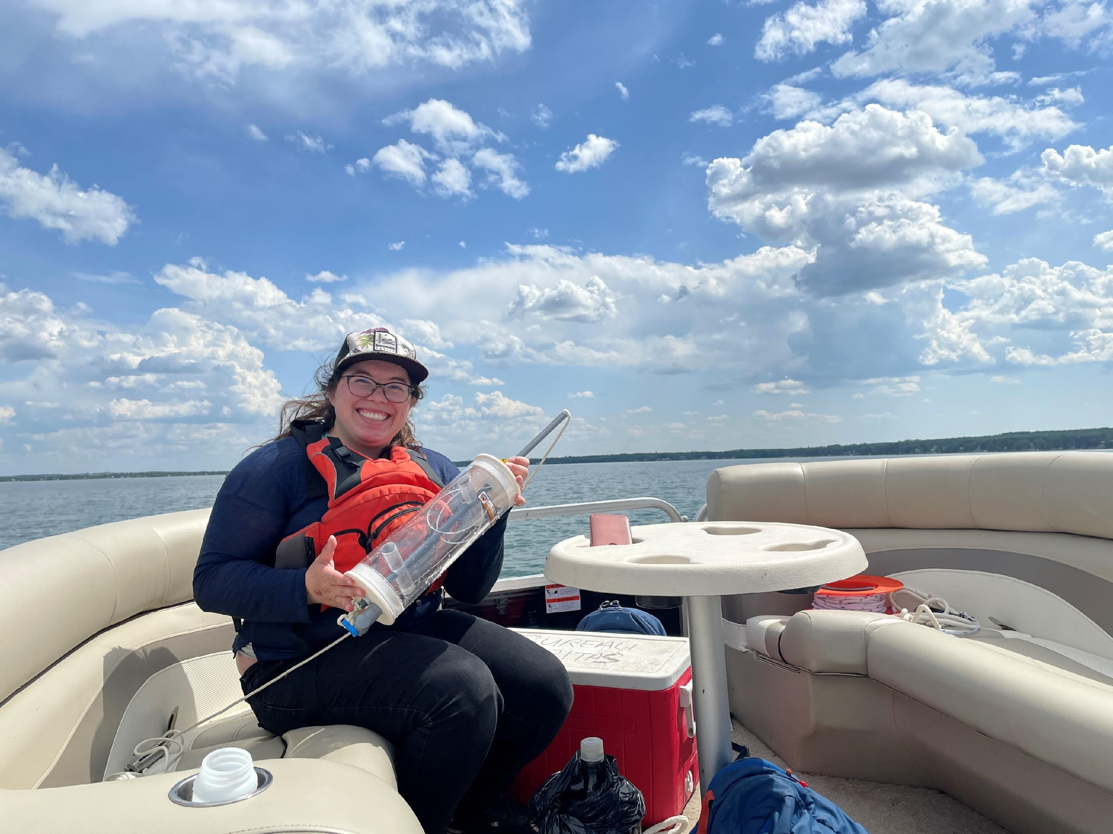
Algal Bloom Tracker
Collaborative research to improve our understanding of lakes.
Using satellite imagery and ground truthing to visualize algal blooms on Alberta’s lakes.
Historical reconstruction and future forecasting of harmful algal blooms.
THANK YOU TO ALBERTA INNOVATES WATER INNOVATION PROGRAM
Jordyn Lajeunesse conducting satellite sampling on Pigeon Lake using a Kemmerer.

Slide 33
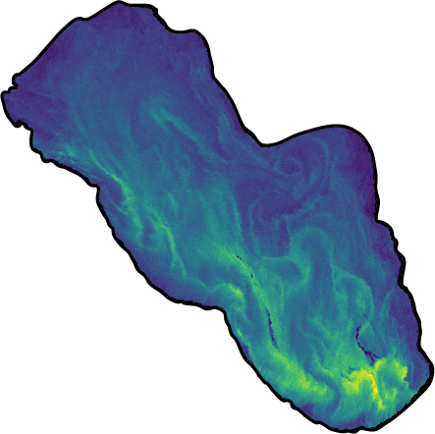
Algal Bloom Tracker
Six lakes monitored over 21 monitoring trips in 2023.
Large collaboration between community partners, researchers, governments, and NGOs.
ABMI is developing the web app component with planned completion in 2025-2026.
Pigeon Lake - Algal Bloom Tracker.

Slide 34
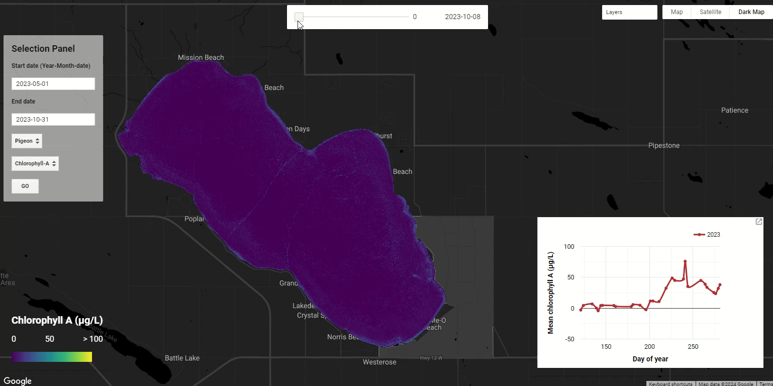

Slide 35
Lake Stewardship Community of Practice
Connect, invigorate, and engage Alberta’s lake watershed stewards.
Quarterly virtual meetings where stewards can network and share information.
Support community level action to support healthy lakes for Alberta’s future.

Slide 36
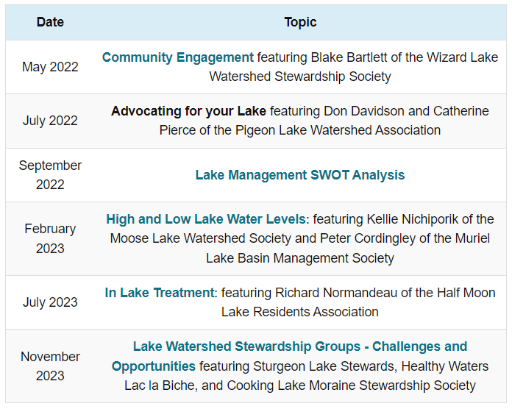
Lake Stewardship Community of Practice

Slide 37
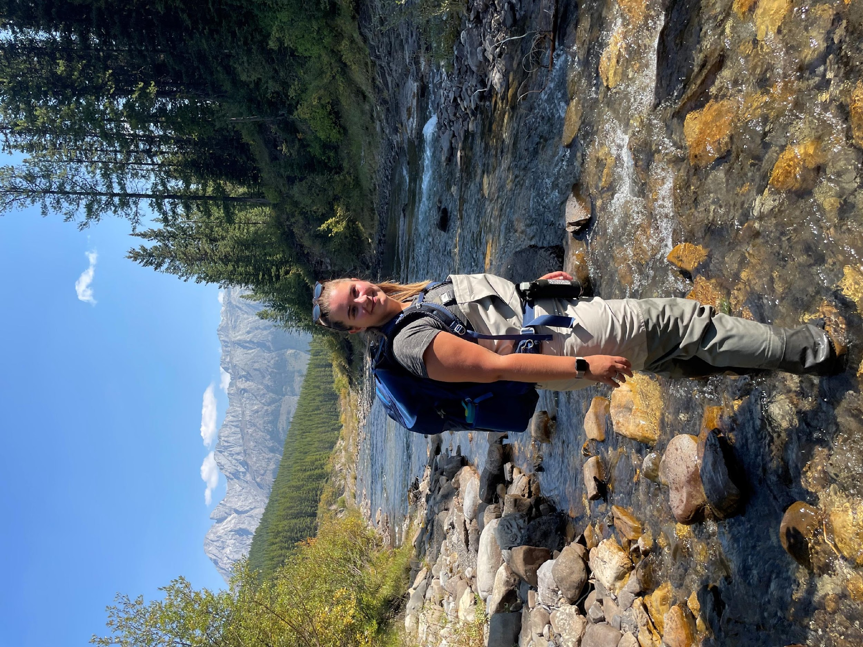
ALMS Scholarship
2023 Recipient: Tara Lepine
An experimental test of the potential for Bull Trout conservation translocations, via instream incubation capsules, in Alberta.

Slide 38
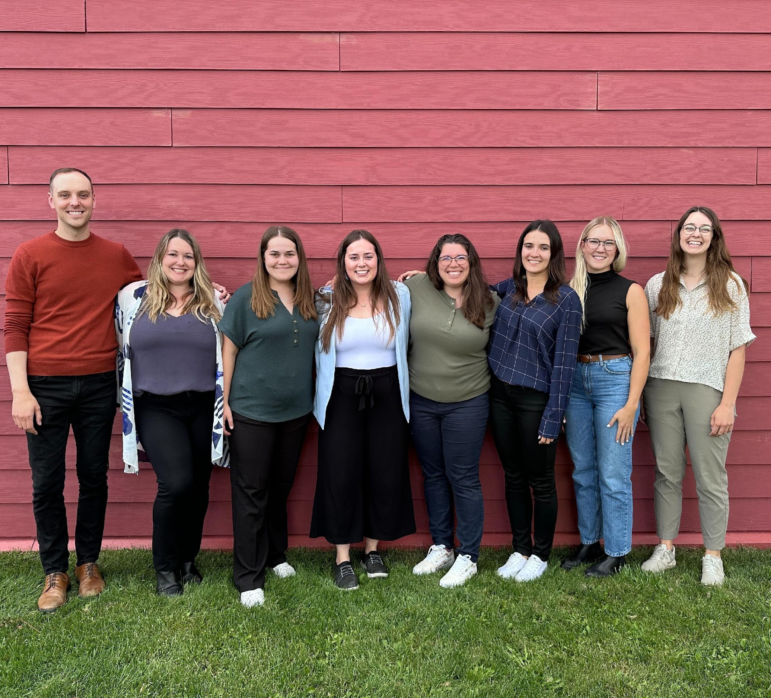
Strategic Objective: A Healthy Organization
ALMS aims to enable the Board and Staff to be successful, satisfied, and sustainable.
In 2023, the Board and staff undertook a review of our Mission Vision and Values and developed a new four year strategic plan.

Slide 39
Clarity of Purpose
Vision: Healthy Lakes for Alberta’s Future
Mission: ALMS builds awareness and understanding of lakes by engaging individuals and communities in monitoring, management, and education.
Values:
ALMS values sustainable, functioning, and resilient lake ecosystems.
ALMS values relationships with diverse audiences built on trust, transparency, and respect.
ALMS values local, traditional, and scientific knowledge systems for stewardship of Alberta's lakes.
ALMS is valued as a credible leader in lake monitoring and management.
Wabamun Lake, Winter 2023-24.

Slide 40
Strategic Plan
The Board of Directors and Staff have identified five key areas of strategic direction for the Alberta Lake Management Society in 2024-2027.
These areas include:
Clarity of Purpose
Building Community
Streamlined Data Collection, Storage, and Reporting
Quality Programs
A Healthy Organization
Canoeing on Sylvan Lake at the 2023 ALMS Workshop.

Slide 41
A Team Effort
Thank you to Directors who have attended Board meetings and committee meetings:
Scholarship Committee
Executive Committee
Workshop Committee
Nominating Committee
Thank you to the Directors who take on extra tasks such:
Vice Chair Kellie Nichiporik
Treasurer Adam Norris
Secretary Jennifer Kerr
Special thanks and farewell to Jennifer Kerr who is an outgoing Director.

Slide 42
Looking Ahead to 2024-2025
Annual Conference in Hinton, AB
Expanded eDNA monitoring
Algal Bloom Tracker Project Year 2
Largest Recreational Water Monitoring Season Yet

Slide 43
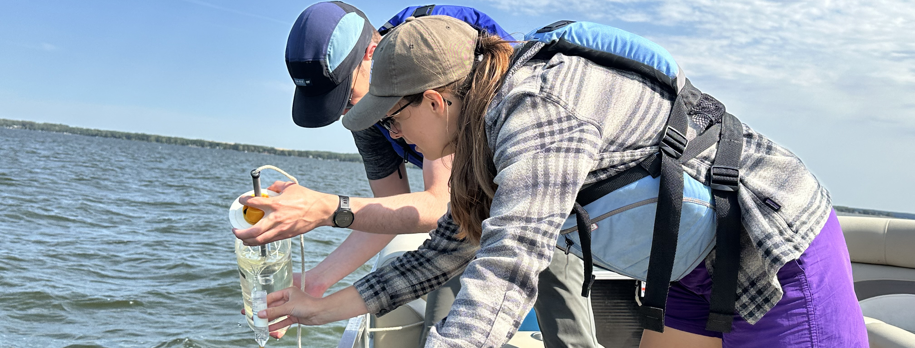
Thank You to sponsors, funders, partners, staff, and volunteers!
Executive Director: Bradley Peter
Alberta Lake Management Society
info@alms.ca

